Slide 1
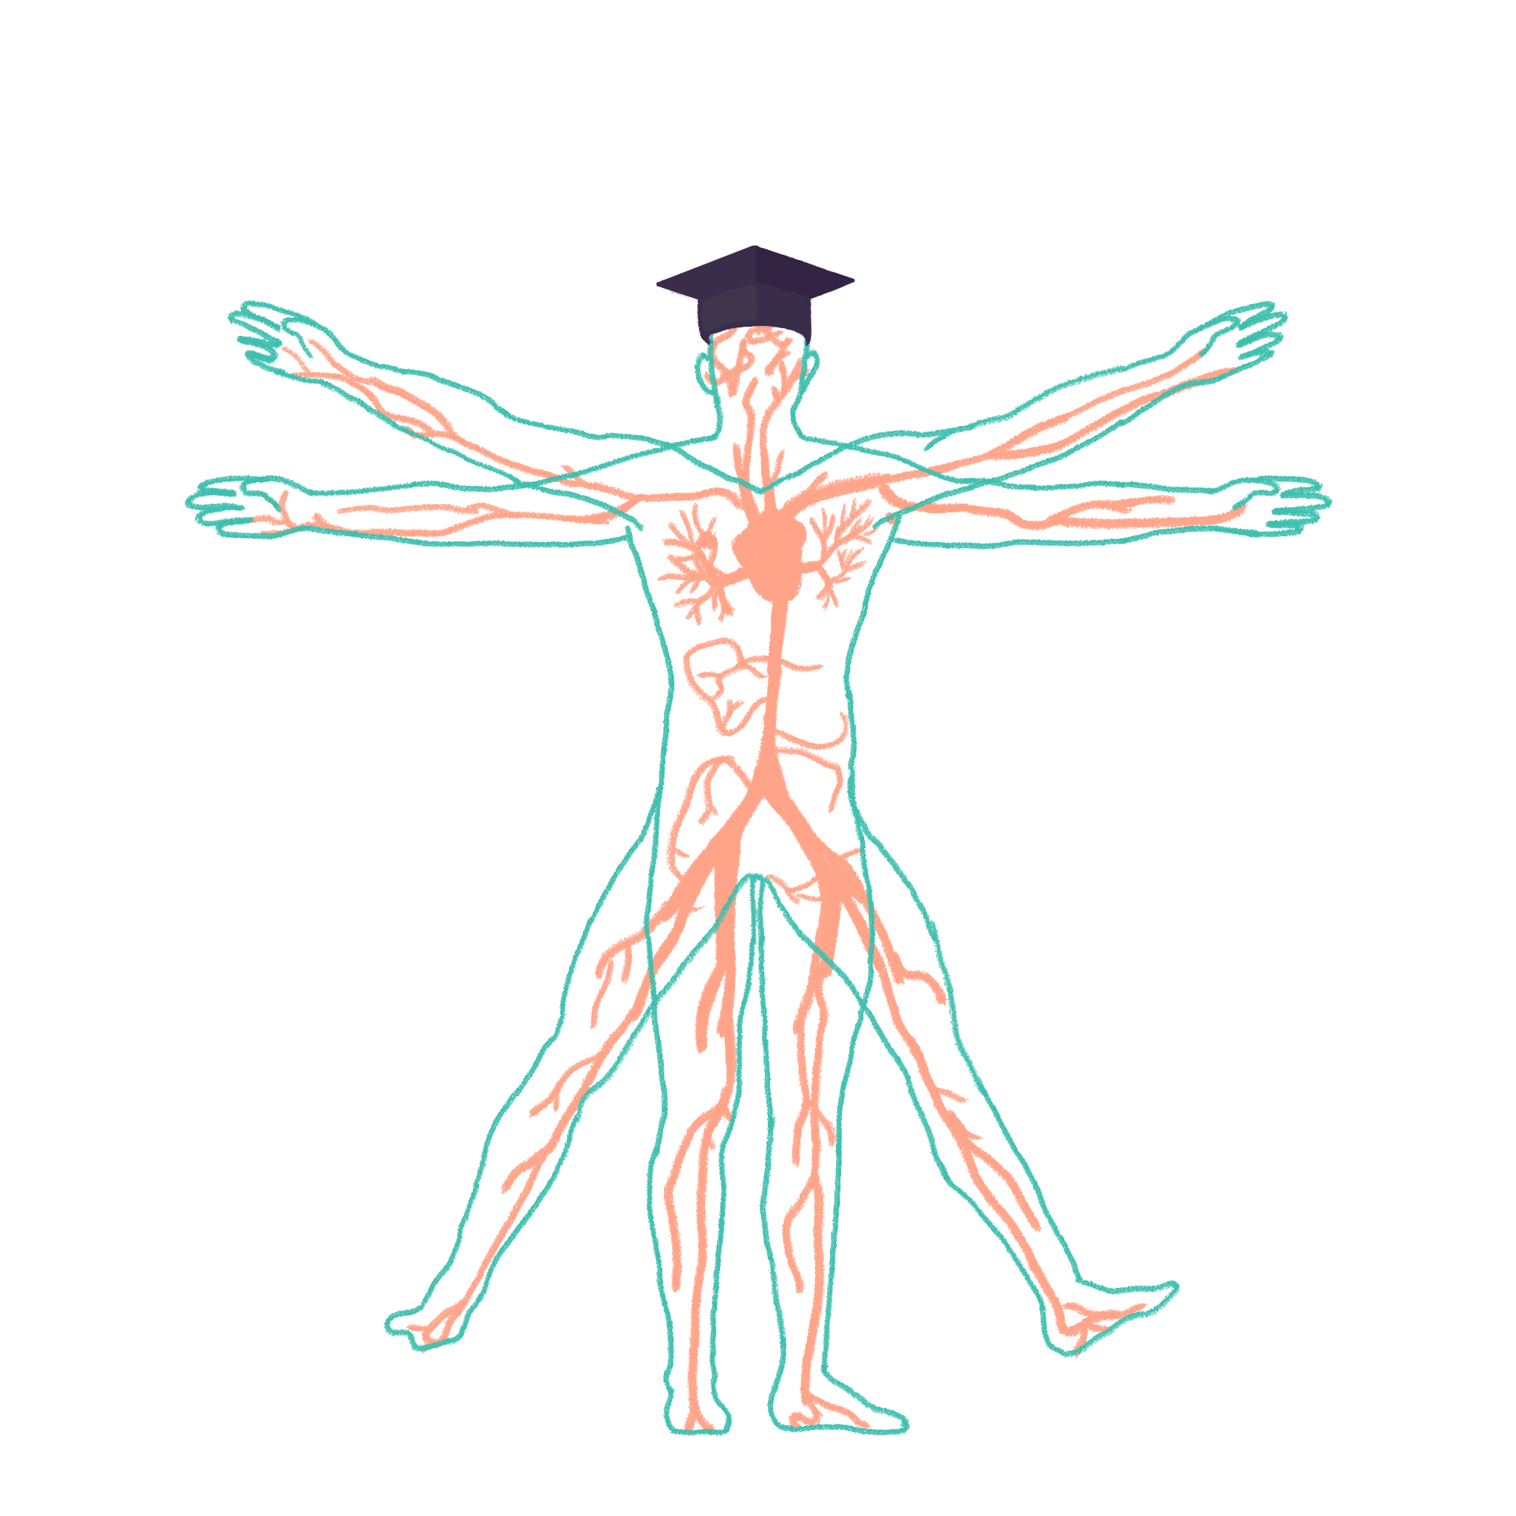
2023/2024

Slide 2
Urology Wrap Up
Phase 2A Revision Session
Emily Finbow & Abby Todd
07/03/24: 6:30pm
The Peer Teaching Society is not liable for false or misleading information…

Slide 3
Aims and Objectives
Practice a range of SBAs and SAQs relating to urological pathology
Discuss common pitfalls in answering urology questions
The Peer Teaching Society is not liable for false or misleading information…

Slide 4
Case 1: Renal Stones
Javid is a 44 year old doctor, who takes himself down to A&E with severe pain in his left side radiating down towards his groin, that has come on in waves. He also has some blood in his urine. He admits that sometimes he can go a full 12 hour shift on AMU without more than a few sips of water. When you ask what he thinks the problem is, he suggests renal stones.
The Peer Teaching Society is not liable for false or misleading information…

Slide 5
Case 1: Renal Stones
Javid is a 44 year old doctor, who takes himself down to A&E with severe pain in his left side radiating down towards his groin, that has come on in waves. He also has some blood in his urine. He admits that sometimes he can go a full 12 hour shift on AMU without more than a few sips of water. When you ask what he thinks the problem is, he suggests renal stones.
What is the most common composition of a renal tract stone? [1 mark]
The Peer Teaching Society is not liable for false or misleading information…

Slide 6
Case 1: Renal Stones
Javid is a 44 year old doctor, who takes himself down to A&E with severe pain in his left side radiating down towards his groin, that has come on in waves. He also has some blood in his urine. He admits that sometimes he can go a full 12 hour shift on AMU without more than a few sips of water. When you ask what he thinks the problem is, he suggests renal stones.
What is the most common composition of a renal tract stone? [1 mark]
Calcium oxalate (35%)
Other types include:
calcium phosphate
struvite stones “staghorn calculi”
urate
cystine (?familial disorder)
Hyperparathyroidism can cause renal stones!
The Peer Teaching Society is not liable for false or misleading information…

Slide 7
Case 1: Renal Stones
Javid is a 44 year old doctor, who takes himself down to A&E with severe pain in his left side radiating down towards his groin, that has come on in waves. He also has some blood in his urine. He admits that sometimes he can go a full 12 hour shift on AMU without more than a few sips of water. When you ask what he thinks the problem is, he suggests renal stones.
Stones are most likely to impact in the narrowest parts of the urinary tract. What are the 3 naturally narrowed points? [3 marks]
The Peer Teaching Society is not liable for false or misleading information…

Slide 8
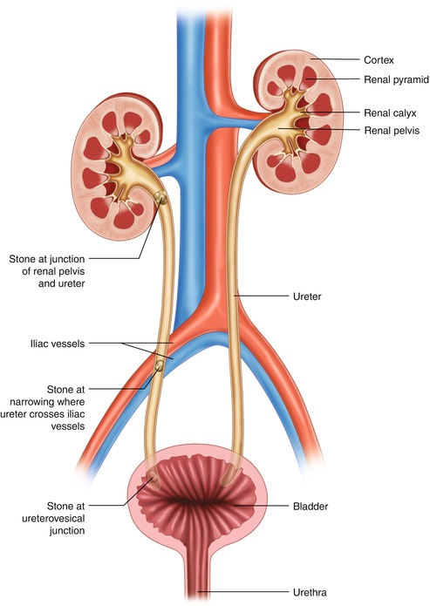
Case 1: Renal Stones
Javid is a 44 year old doctor, who takes himself down to A&E with severe pain in his left side radiating down towards his groin, that has come on in waves. He also has some blood in his urine. He admits that sometimes he can go a full 12 hour shift on AMU without more than a few sips of water. When you ask what he thinks the problem is, he suggests renal stones.
Stones are most likely to impact in the narrowest parts of the urinary tract. What are the 3 naturally narrowed points? [3 marks]
Pelviureteric junction (where renal pelvis becomes ureter)
Crossing the pelvic brim
Vesicoureteric junction (where the ureter enters the bladder)
The Peer Teaching Society is not liable for false or misleading information…
https://www.grepmed.com/images/11765/ureteric-stricture

Slide 9
Case 1: Renal Stones
Javid is a 44 year old doctor, who takes himself down to A&E with severe pain in his left side radiating down towards his groin, that has come on in waves. He also has some blood in his urine. He admits that sometimes he can go a full 12 hour shift on AMU without more than a few sips of water. When you ask what he thinks the problem is, he suggests renal stones.
Name 2 other differentials for haematuria? [2 marks]
The Peer Teaching Society is not liable for false or misleading information…

Slide 10
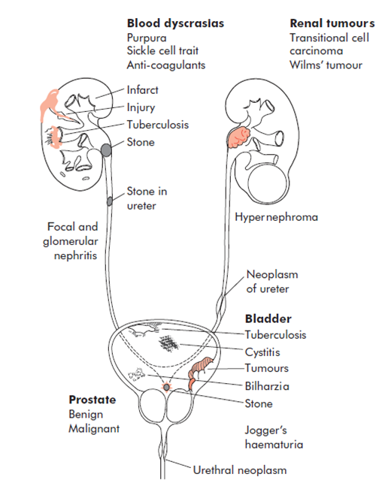
Case 1: Renal Stones
Javid is a 44 year old doctor, who takes himself down to A&E with severe pain in his left side radiating down towards his groin, that has come on in waves. He also has some blood in his urine. He admits that sometimes he can go a full 12 hour shift on AMU without more than a few sips of water. When you ask what he thinks the problem is, he suggests renal stones.
Name 2 other differentials for haematuria? [2 marks]
Bladder cancer / renal cancer / prostate cancer
BPH
UTI / pyelonephritis / Schistosomiasis
Trauma
Radiation cystitis
Glomerulonephritis / nephritic syndrome
Instrumentation / iatrogenic / catheterisation / cystoscopy
The Peer Teaching Society is not liable for false or misleading information…
https://mindthebleep.com/haematuria/

Slide 11
Case 1: Renal Stones
Javid is a 44 year old doctor, who takes himself down to A&E with severe pain in his left side radiating down towards his groin, that has come on in waves. He also has some blood in his urine. He admits that sometimes he can go a full 12 hour shift on AMU without more than a few sips of water. When you ask what he thinks the problem is, he suggests renal stones.
What is the gold standard imaging for diagnosis of renal stones? [1 mark]
The Peer Teaching Society is not liable for false or misleading information…

Slide 12
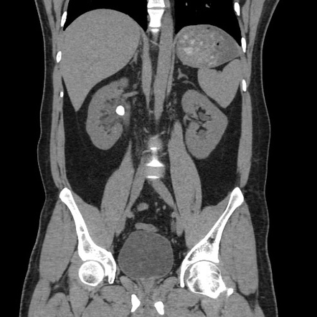
Case 1: Renal Stones
Javid is a 44 year old doctor, who takes himself down to A&E with severe pain in his left side radiating down towards his groin, that has come on in waves. He also has some blood in his urine. He admits that sometimes he can go a full 12 hour shift on AMU without more than a few sips of water. When you ask what he thinks the problem is, he suggests renal stones.
What is the gold standard imaging for diagnosis of renal stones?[1 mark]
CT Kidney Ureter Bladder
Why not USS?
Why not xray?
The Peer Teaching Society is not liable for false or misleading information…
https://radiopaedia.org/cases/renal-pelvic-calculus

Slide 13
Case 1: Renal Stones
Javid is a 44 year old doctor, who takes himself down to A&E with severe pain in his left side radiating down towards his groin, that has come on in waves. He also has some blood in his urine. He admits that sometimes he can go a full 12 hour shift on AMU without more than a few sips of water. When you ask what he thinks the problem is, he suggests renal stones.
The Peer Teaching Society is not liable for false or misleading information…

Slide 14
Case 2: Haematuria
Steven is a 56 year old man who visits his GP complaining of red-coloured urine. The urine is dipped which is positive for blood but otherwise normal. He is referred on a 2-week-wait to urology.
The Peer Teaching Society is not liable for false or misleading information…

Slide 15
Case 2: Haematuria
Steven is a 56 year old man who visits his GP complaining of red-coloured urine. The urine is dipped which is positive for blood but otherwise normal. He has no other symptoms. He is referred on a 2-week-wait to urology.
What condition is the GP worried about that has prompted this referral? [1 mark]
The Peer Teaching Society is not liable for false or misleading information…

Slide 16
Case 2: Haematuria
Steven is a 56 year old man who visits his GP complaining of red-coloured urine. The urine is dipped which is positive for blood but otherwise normal. He has no other symptoms. He is referred on a 2-week-wait to urology.
What condition is the GP worried about that has prompted this referral? [1 mark]
Bladder Cancer
The Peer Teaching Society is not liable for false or misleading information…

Slide 17
Case 2: Haematuria
Steven is a 56 year old man who visits his GP complaining of red-coloured urine. The urine is dipped which is positive for blood but otherwise normal. He has no other symptoms. He is referred on a 2-week-wait to urology.
What condition is the GP worried about that has prompted this referral? [1 mark]
Bladder Cancer - 2 WW referral for 45 years + with unexplained visible haematuria without UTI or that persists/recurs after UTI treatment
The Peer Teaching Society is not liable for false or misleading information…

Slide 18
Case 2: Haematuria
Steven is a 56 year old man who visits his GP complaining of red-coloured urine. The urine is dipped which is positive for blood but otherwise normal. He has no other symptoms. He is referred on a 2-week-wait to urology.
What is the most common type of bladder cancer in the uk? [1 mark]
The Peer Teaching Society is not liable for false or misleading information…

Slide 19
Case 2: Haematuria
Steven is a 56 year old man who visits his GP complaining of red-coloured urine. The urine is dipped which is positive for blood but otherwise normal. He has no other symptoms. He is referred on a 2-week-wait to urology.
What is the most common type of bladder cancer in the uk? [1 mark]
transitional cell carcinoma
The Peer Teaching Society is not liable for false or misleading information…

Slide 20
Case 2: Haematuria
Steven is a 56 year old man who visits his GP complaining of red-coloured urine. The urine is dipped which is positive for blood but otherwise normal. He has no other symptoms. He is referred on a 2-week-wait to urology.
Name 3 risk factors of bladder cancer [3 marks]
The Peer Teaching Society is not liable for false or misleading information…

Slide 21
Case 2: Haematuria
Steven is a 56 year old man who visits his GP complaining of red-coloured urine. The urine is dipped which is positive for blood but otherwise normal. He has no other symptoms. He is referred on a 2-week-wait to urology.
Name 3 risk factors of bladder cancer [3 marks]
Male sex (2.5 x more common in men)
Age 50 + years (rare before this)
Smoking (biggest risk factor)
Occupation/increased chemical exposure - working with dyes, textiles, rubbers, paints, plastics, leather tanning
The Peer Teaching Society is not liable for false or misleading information…

Slide 22
Case 2: Haematuria
Steven is a 56 year old man who visits his GP complaining of red-coloured urine. The urine is dipped which is positive for blood but otherwise normal. He has no other symptoms. He is referred on a 2-week-wait to urology.
What is the initial investigation Steven will undergo with the urology team? [1 marks]
The Peer Teaching Society is not liable for false or misleading information…

Slide 23
Case 2: Haematuria
Steven is a 56 year old man who visits his GP complaining of red-coloured urine. The urine is dipped which is positive for blood but otherwise normal. He has no other symptoms. He is referred on a 2-week-wait to urology.
What is the initial investigation Steven will undergo with the urology team? [1 marks]
Flexible cystoscopy.
(USS KUB are sometimes used in low risk patients as safer but less sensitive
CT urogram can be used. It is more sensitive but ionizing.)
The Peer Teaching Society is not liable for false or misleading information…

Slide 24
Case 2: Haematuria
Steven is a 56 year old man who visits his GP complaining of red-coloured urine. The urine is dipped which is positive for blood but otherwise normal. He has no other symptoms. He is referred on a 2-week-wait to urology.
Name 2 treatments for bladder cancer? [2 marks]
The Peer Teaching Society is not liable for false or misleading information…

Slide 25
Case 2: Haematuria
Steven is a 56 year old man who visits his GP complaining of red-coloured urine. The urine is dipped which is positive for blood but otherwise normal. He has no other symptoms. He is referred on a 2-week-wait to urology.
Name 2 treatments for bladder cancer? [2 marks]
Transurethral resection of bladder tumour (TURBT) - most common
Chemotherapy
BCG treatment (uses a variant of the BCG vaccine)
Cystectomy
Radiotherapy
NHS website has good info on this.
The Peer Teaching Society is not liable for false or misleading information…

Slide 26
Case 3: LUTS
John is a 76 year old man who attends the GP reporting lower urinary tract symptoms (LUTS). He has hypertension and high cholesterol, which he takes amlodipine and simvastatin for respectively, and had a knee replacement 1 year ago. Otherwise, he is generally fit and well.
The Peer Teaching Society is not liable for false or misleading information…

Slide 27
Case 3: LUTS
John is a 76 year old man who attends the GP reporting lower urinary tract symptoms (LUTS). He has hypertension and high cholesterol, which he takes amlodipine and simvastatin for respectively, and had a knee replacement 1 year ago. Otherwise, he is generally fit and well.
In terms of LUTS, name 2 voiding and 2 storage symptoms that you would enquire about [2 marks]
The Peer Teaching Society is not liable for false or misleading information…

Slide 28
Case 3: LUTS
John is a 76 year old man who attends the GP reporting lower urinary tract symptoms (LUTS). He has hypertension and high cholesterol, which he takes amlodipine and simvastatin for respectively, and had a knee replacement 1 year ago. Otherwise, he is generally fit and well.
In terms of LUTS, name 2 voiding and 2 storage symptoms that you would enquire about [2 marks]
Voiding: hesitancy / weak or intermittent urinary stream / splitting / spraying / straining / incomplete emptying / terminal dribbling (Any 2 for 1 mark)
Storage: urgency / frequency / nocturia / urinary incontinence / feeling the need to urinate again immediately after (Any 2 for 1 mark)
The Peer Teaching Society is not liable for false or misleading information…

Slide 29
Case 3: LUTS
John is a 76 year old man who attends the GP reporting lower urinary tract symptoms (LUTS). He has hypertension and high cholesterol, which he takes amlodipine and simvastatin for respectively, and had a knee replacement 1 year ago. Otherwise, he is generally fit and well.
After you take a thorough history, name 2 steps that should be taken at this GP appointment? [2 marks]
The Peer Teaching Society is not liable for false or misleading information…

Slide 30
Case 3: LUTS
John is a 76 year old man who attends the GP reporting lower urinary tract symptoms (LUTS). He has hypertension and high cholesterol, which he takes amlodipine and simvastatin for respectively, and had a knee replacement 1 year ago. Otherwise, he is generally fit and well.
After you take a thorough history, name 2 steps that should be taken at this GP appointment? [2 marks]
Abdominal examination / external genitalia examination / digital rectal examination
Organise PSA blood test
Consider 2WW referral
International Prostate Symptom Score
Give a bladder diary / ask to complete a urine frequency-volume chart for 3 days
The Peer Teaching Society is not liable for false or misleading information…
Notes:
Examine the abdomen for signs of a distended bladder, such as abdominal distention and suprapubic dullness on percussion.
Check the external genitalia to identify conditions that may cause or contribute to LUTS, for example phimosis, meatal stenosis, or penile cancer.
Perform a digital rectal examination to assess the prostate for size, consistency, nodules, and tenderness.
Examine the perineum and/or lower limbs to evaluate motor and sensory function.
Ask men with bothersome LUTS to complete a urinary frequency-volume chart for at least 3 days, to distinguish between urinary frequency, polyuria, nocturia, and nocturnal polyuria.

Slide 31
Case 3: LUTS
John is a 76 year old man who attends the GP reporting lower urinary tract symptoms (LUTS). He has hypertension and high cholesterol, which he takes amlodipine and simvastatin for respectively, and had a knee replacement 1 year ago. Otherwise, he is generally fit and well.
Other than prostate cancer, name 2 factors that can increase a PSA level? [2 marks]
The Peer Teaching Society is not liable for false or misleading information…

Slide 32
Case 3: LUTS
John is a 76 year old man who attends the GP reporting lower urinary tract symptoms (LUTS). He has hypertension and high cholesterol, which he takes amlodipine and simvastatin for respectively, and had a knee replacement 1 year ago. Otherwise, he is generally fit and well.
Other than prostate cancer, name 2 factors that can increase a PSA level? [2 marks]
Any 2 of:
BPH
Prostatitis
UTI
(Vigorous) exercise
Ejaculation
Receiving anal sex
Digital rectal exam
Prostate biopsy
Catheterisation
Urological surgery
Urinary retention
The Peer Teaching Society is not liable for false or misleading information…

Slide 33
Case 3: LUTS
John is a 76 year old man who attends the GP reporting lower urinary tract symptoms (LUTS). He has hypertension and high cholesterol, which he takes amlodipine and simvastatin for respectively, and had a knee replacement 1 year ago. Otherwise, he is generally fit and well.
The Peer Teaching Society is not liable for false or misleading information…

Slide 34
Case 4: Testicular pain
Luke is an 11 year old boy who attends paediatric A & E with pain in his scrotum. Upon further questioning he tells you the pain is very severe, and came on suddenly in his left testicle. He feels nauseous and has vomited once.
The Peer Teaching Society is not liable for false or misleading information…

Slide 35
Case 4: Testicular pain
Luke is an 11 year old boy who attends paediatric A & E with pain in his scrotum. Upon further questioning he tells you the pain is very severe, and came on suddenly in his left testicle. He feels nauseous and has vomited once.
The pain continues despite elevation of the testes. Luke is negative for what sign? [1 mark]
The Peer Teaching Society is not liable for false or misleading information…

Slide 36
Case 4: Testicular pain
Luke is an 11 year old boy who attends paediatric A & E with pain in his scrotum. Upon further questioning he tells you the pain is very severe, and came on suddenly in his left testicle. He feels nauseous and has vomited once.
The pain continues despite elevation of the testes. Luke is negative for what sign? [1 mark]
Phren’s sign.
The Peer Teaching Society is not liable for false or misleading information…

Slide 37
Case 4: Testicular pain
Luke is an 11 year old boy who attends paediatric A & E with pain in his scrotum. Upon further questioning he tells you the pain is very severe, and came on suddenly in his left testicle. He feels nauseous and has vomited once.
The pain continues despite elevation of the testes. Luke is negative for what sign? [1 mark]
Phren’s sign.
2 main causes of testicular pain:
Phren’s positive - epididymitis
Phren’s negative - testicular torsion
The Peer Teaching Society is not liable for false or misleading information…

Slide 38
Case 4: Testicular pain
Luke is an 11 year old boy who attends paediatric A & E with pain in his scrotum. Upon further questioning he tells you the pain is very severe, and came on suddenly in his left testicle. He feels nauseous and has vomited once.
The cremasteric reflex is absent. How is this reflex elicited and what is a normal response? [2 marks]
The Peer Teaching Society is not liable for false or misleading information…

Slide 39
Case 4: Testicular pain
Luke is an 11 year old boy who attends paediatric A & E with pain in his scrotum. Upon further questioning he tells you the pain is very severe, and came on suddenly in his left testicle. He feels nauseous and has vomited once.
The cremasteric reflex is absent. How is this reflex elicited and what is a normal response? [2 marks]
The medial thigh is stroked in a downward direction.
In a normal response, the cremasteric muscle contracts, pulling the scrotum and testis superiorly on the side that is assessed.
The Peer Teaching Society is not liable for false or misleading information…

Slide 40
Case 4: Testicular pain
Luke is an 11 year old boy who attends paediatric A & E with pain in his scrotum. Upon further questioning he tells you the pain is very severe, and came on suddenly in his left testicle. He feels nauseous and has vomited once.
The A & E doctor thinks this is most likely testicular torsion and refers to urology. What will the urology team do to investigate and manage this patient? [2 marks]
The Peer Teaching Society is not liable for false or misleading information…

Slide 41
Case 4: Testicular pain
Luke is an 11 year old boy who attends paediatric A & E with pain in his scrotum. Upon further questioning he tells you the pain is very severe, and came on suddenly in his left testicle. He feels nauseous and has vomited once.
The A & E doctor thinks this is most likely testicular torsion and refers to urology. What will the urology team do to investigate and manage this patient? [2 marks]
surgical exploration
orchidopexy - cord and testis will be untwisted and (usually) both testicles fixed to the scrotum
(NOT USS - no time.)
The Peer Teaching Society is not liable for false or misleading information…

Slide 42
Case 4: Testicular pain
Luke is an 11 year old boy who attends paediatric A & E with pain in his scrotum. Upon further questioning he tells you the pain is very severe, and came on suddenly in his left testicle. He feels nauseous and has vomited once.
The Peer Teaching Society is not liable for false or misleading information…

Slide 43
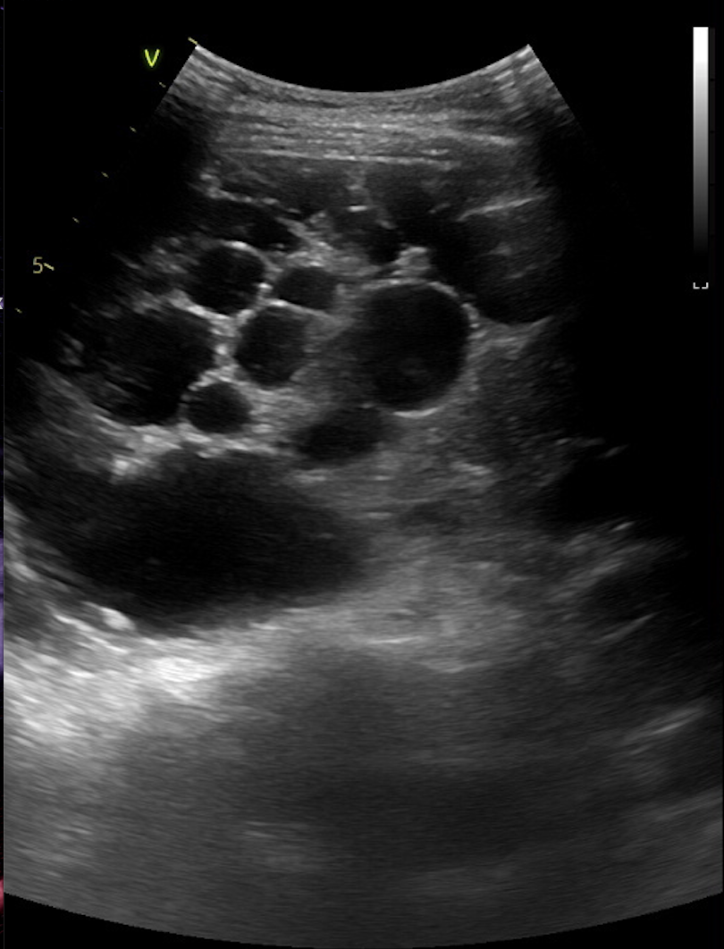
Case 5: Enlarged Kidneys
Simon, a 52 year old, comes into your clinic complaining of fatigue, foamy and bloody urine and oedema in his legs. He has a blood pressure of 172 / 86. On examination, you palpate his kidneys which seem abnormally large.
He has an ultrasound, which shows the following:
The Peer Teaching Society is not liable for false or misleading information…
Case courtesy of Herberth Vinicio Vargas, Radiopaedia.org, rID: 160897

Slide 44
Case 5: Enlarged Kidneys
Simon, a 52 year old, comes into your clinic complaining of fatigue, foamy and bloody urine and oedema in his legs. He has a blood pressure of 172 / 86. On examination, you palpate his kidneys which seem abnormally large. He has an ultrasound which shows the following:
Which of the following is true regarding the most likely differential?
the most commonly affected gene is PKD2 on chromosome 4
this condition is associated with berry aneurysms and therefore extradural haemorrhages
this condition is associated with mitral regurgitation
tolvaptan is the only curative medication option
he should not be given ACE inhibitors for his hypertension
Case courtesy of Herberth Vinicio Vargas, Radiopaedia.org, rID: 160897
The Peer Teaching Society is not liable for false or misleading information…

Slide 45
Case 5: Enlarged Kidneys
Simon, a 52 year old, comes into your clinic complaining of fatigue, foamy and bloody urine and oedema in his legs. He has a blood pressure of 172 / 86. On examination, you palpate his kidneys which seem abnormally large. He has an ultrasound which shows the following:
Which of the following is true regarding the most likely differential?
the most commonly affected gene is PKD2 on chromosome 4
this condition is associated with berry aneurysms and therefore extradural haemorrhages
this condition is associated with mitral regurgitation
tolvaptan is the only curative medication option
he should not be given ACE inhibitors for his hypertension
Case courtesy of Herberth Vinicio Vargas, Radiopaedia.org, rID: 160897
The Peer Teaching Society is not liable for false or misleading information…

Slide 46
Case 5: Enlarged Kidneys
Simon, a 52 year old, comes into your clinic complaining of fatigue, foamy and bloody urine and oedema in his legs. He has a blood pressure of 172 / 86. On examination, you palpate his kidneys which seem abnormally large. He has an ultrasound which shows the following:
Which of the following is true regarding the most likely differential? ADPKD
the most commonly affected gene is PKD2 on chromosome 4
this condition is associated with berry aneurysms and therefore extradural haemorrhages
this condition is associated with mitral regurgitation
tolvaptan is the only curative medication option
he should not be given ACE inhibitors for his hypertension
Case courtesy of Herberth Vinicio Vargas, Radiopaedia.org, rID: 160897
The Peer Teaching Society is not liable for false or misleading information…

Slide 47
Case 5: Enlarged Kidneys
Simon, a 52 year old, comes into your clinic complaining of fatigue, foamy and bloody urine and oedema in his legs. He has a blood pressure of 172 / 86. On examination, you palpate his kidneys which seem abnormally large. He has an ultrasound which shows the following:
Which of the following is true regarding the most likely differential? ADPKD
the most commonly affected gene is PKD2 on chromosome 4 (15%) - PKD1 on chromosome 16 (85%)
this condition is associated with berry aneurysms and therefore extradural haemorrhages
this condition is associated with mitral regurgitation
tolvaptan is the only curative medication option
he should not be given ACE inhibitors for his hypertension
Case courtesy of Herberth Vinicio Vargas, Radiopaedia.org, rID: 160897
The Peer Teaching Society is not liable for false or misleading information…

Slide 48
Case 5: Enlarged Kidneys
Simon, a 52 year old, comes into your clinic complaining of fatigue, foamy and bloody urine and oedema in his legs. He has a blood pressure of 172 / 86. On examination, you palpate his kidneys which seem abnormally large. He has an ultrasound which shows the following:
Which of the following is true regarding the most likely differential? ADPKD
the most commonly affected gene is PKD2 on chromosome 4 (15%) - PKD1 on chromosome 16 (85%)
this condition is associated with berry aneurysms and therefore extradural haemorrhages - subarachnoid
this condition is associated with mitral regurgitation
tolvaptan is the only curative medication option
he should not be given ACE inhibitors for his hypertension
Case courtesy of Herberth Vinicio Vargas, Radiopaedia.org, rID: 160897
The Peer Teaching Society is not liable for false or misleading information…

Slide 49
Case 5: Enlarged Kidneys
Simon, a 52 year old, comes into your clinic complaining of fatigue, foamy and bloody urine and oedema in his legs. He has a blood pressure of 172 / 86. On examination, you palpate his kidneys which seem abnormally large. He has an ultrasound which shows the following:
Which of the following is true regarding the most likely differential? ADPKD
the most commonly affected gene is PKD2 on chromosome 4 (15%) - PKD1 on chromosome 16 (85%)
this condition is associated with berry aneurysms and therefore extradural haemorrhages - subarachnoid
this condition is associated with mitral regurgitation
tolvaptan is the only curative medication option - no cure, tolvaptan can slow cyst development + progression of renal failure
he should not be given ACE inhibitors for his hypertension - ACEi are appropriate
Case courtesy of Herberth Vinicio Vargas, Radiopaedia.org, rID: 160897

Slide 50
Case 5: Polycystic Kidney Disease
Simon, a 52 year old, comes into your clinic complaining of fatigue, foamy and bloody urine and oedema in his legs. He has a blood pressure of 172 / 86. On examination, you palpate his kidneys which seem abnormally large.
He has an ultrasound, which shows the following:
The Peer Teaching Society is not liable for false or misleading information…
Case courtesy of Herberth Vinicio Vargas, Radiopaedia.org, rID: 160897

Slide 51
Case 6: Urinary incontinence
Sheila is a 51 year old lady who presents to her GP with problems holding in her urine. She explains that she can feel normal and is suddenly hit with the feeling of needing to wee. Once this feeling comes she finds it very hard to hold in her urine and finds this very embarrassing.
The Peer Teaching Society is not liable for false or misleading information…

Slide 52
Case 6: Urinary incontinence
Sheila is a 51 year old lady who presents to her GP with problems holding in her urine. She explains that she can feel normal and is suddenly hit with the feeling of needing to wee. Once this feeling comes she finds it very hard to hold in her urine and finds this very embarrassing.
Which statement about Sheila’s problem is true?
Duloxetine is the first-line pharmacological management
3 months of pelvic floor muscle training is the first-line management
It is caused by detrusor muscle overactivity
The GP should refer immediately for urodynamic testing
There are no other conditions that could be causing this problem
The Peer Teaching Society is not liable for false or misleading information…

Slide 53
Case 6: Urinary incontinence
Sheila is a 51 year old lady who presents to her GP with problems holding in her urine. She explains that she can feel normal and is suddenly hit with the feeling of needing to wee. Once this feeling comes she finds it very hard to hold in her urine and finds this very embarrassing.
Which statement about Sheila’s problem is true?
Duloxetine is the first-line pharmacological management
3 months of pelvic floor muscle training is the first-line management
It is caused by detrusor muscle overactivity
The GP should refer immediately for urodynamic testing
There are no other conditions that could be causing this problem
The Peer Teaching Society is not liable for false or misleading information…

Slide 54
Case 6: Urinary incontinence
Sheila is a 51 year old lady who presents to her GP with problems holding in her urine. She explains that she can feel normal and is suddenly hit with the feeling of needing to wee. Once this feeling comes she finds it very hard to hold in her urine and finds this very embarrassing.
Which statement about Sheila’s problem is true? URGE URINARY INCONTINENCE
Duloxetine is the first-line pharmacological management
3 months of pelvic floor muscle training is the first-line management
It is caused by detrusor muscle overactivity
The GP should refer immediately for urodynamic testing
There are no other conditions that could be causing this problem
The Peer Teaching Society is not liable for false or misleading information…

Slide 55
Case 6: Urinary incontinence
Sheila is a 51 year old lady who presents to her GP with problems holding in her urine. She explains that she can feel normal and is suddenly hit with the feeling of needing to wee. Once this feeling comes she finds it very hard to hold in her urine and finds this very embarrassing.
Which statement about Sheila’s problem is true? URGE URINARY INCONTINENCE
Duloxetine is the first-line pharmacological management - oxybutynin (anticholinergic), duloxetine is used for stress urinary incontinence
3 months of pelvic floor muscle training is the first-line management
It is caused by detrusor muscle overactivity
The GP should refer immediately for urodynamic testing
There are no other conditions that could be causing this problem
The Peer Teaching Society is not liable for false or misleading information…

Slide 56
Case 6: Urinary incontinence
Sheila is a 51 year old lady who presents to her GP with problems holding in her urine. She explains that she can feel normal and is suddenly hit with the feeling of needing to wee. Once this feeling comes she finds it very hard to hold in her urine and finds this very embarrassing.
Which statement about Sheila’s problem is true? URGE URINARY INCONTINENCE
Duloxetine is the first-line pharmacological management - oxybutynin (anticholinergic), duloxetine is used for stress urinary incontinence
3 months of pelvic floor muscle training is the first-line management - this is for stress urinary incontinence, for urge it is 6 weeks of bladder retraining
It is caused by detrusor muscle overactivity
The GP should refer immediately for urodynamic testing
There are no other conditions that could be causing this problem
The Peer Teaching Society is not liable for false or misleading information…

Slide 57
Case 6: Urinary incontinence
Sheila is a 51 year old lady who presents to her GP with problems holding in her urine. She explains that she can feel normal and is suddenly hit with the feeling of needing to wee. Once this feeling comes she finds it very hard to hold in her urine and finds this very embarrassing.
Which statement about Sheila’s problem is true? URGE URINARY INCONTINENCE
Duloxetine is the first-line pharmacological management - oxybutynin (anticholinergic), duloxetine is used for stress urinary incontinence
3 months of pelvic floor muscle training is the first-line management - this is for stress urinary incontinence, for urge it is 6 weeks of bladder retraining
It is caused by detrusor muscle overactivity
The GP should refer immediately for urodynamic testing
There are no other conditions that could be causing this problem
The Peer Teaching Society is not liable for false or misleading information…

Slide 58
Case 6: Urinary incontinence
Sheila is a 51 year old lady who presents to her GP with problems holding in her urine. She explains that she can feel normal and is suddenly hit with the feeling of needing to wee. Once this feeling comes she finds it very hard to hold in her urine and finds this very embarrassing.
Which statement about Sheila’s problem is true? URGE URINARY INCONTINENCE
Duloxetine is the first-line pharmacological management - oxybutynin (anticholinergic), duloxetine is used for stress urinary incontinence
3 months of pelvic floor muscle training is the first-line management - this is for stress urinary incontinence, for urge it is 6 weeks of bladder retraining
It is caused by detrusor muscle overactivity
The GP should refer immediately for urodynamic testing - later maybe
There are no other conditions that could be causing this problem
The Peer Teaching Society is not liable for false or misleading information…

Slide 59
Case 6: Urinary incontinence
Sheila is a 51 year old lady who presents to her GP with problems holding in her urine. She explains that she can feel normal and is suddenly hit with the feeling of needing to wee. Once this feeling comes she finds it very hard to hold in her urine and finds this very embarrassing.
Which statement about Sheila’s problem is true? URGE URINARY INCONTINENCE
Duloxetine is the first-line pharmacological management - oxybutynin (anticholinergic), duloxetine is used for stress urinary incontinence
3 months of pelvic floor muscle training is the first-line management - this is for stress urinary incontinence, for urge it is 6 weeks of bladder retraining
It is caused by detrusor muscle overactivity
The GP should refer immediately for urodynamic testing - later maybe
There are no other conditions that could be causing this problem - caffeine, alcohol, idiopathic, Parkinson's, MS, Diabetes, Obesity
The Peer Teaching Society is not liable for false or misleading information…

Slide 60
Case 6: Urinary incontinence
Sheila is a 51 year old lady who presents to her GP with problems holding in her urine. She explains that she can feel normal and is suddenly hit with the feeling of needing to wee. Once this feeling comes she finds it very hard to hold in her urine and finds this very embarrassing.
The Peer Teaching Society is not liable for false or misleading information…

Slide 61
Conclusion
Opportunity to practice questions on a range of urological presentations and pathologies, and identify your stronger and weaker areas
Any Questions?
The Peer Teaching Society is not liable for false or misleading information…

Slide 62
References
https://teachmesurgery.com/urology/kidney/renal-stones/
https://teachmesurgery.com/urology/genital-tract/testicular-torsion/
https://www.nhs.uk/conditions/bladder-cancer/
https://cks.nice.org.uk/topics/luts-in-men/
https://cks.nice.org.uk/topics/urological-cancers-recognition-referral/
https://www.osmosis.org/answers/Prehns-sign#
https://zerotofinals.com/medicine/renal/pkd/
https://cks.nice.org.uk/topics/incontinence-urinary-in-women/
The Peer Teaching Society is not liable for false or misleading information…

Slide 63
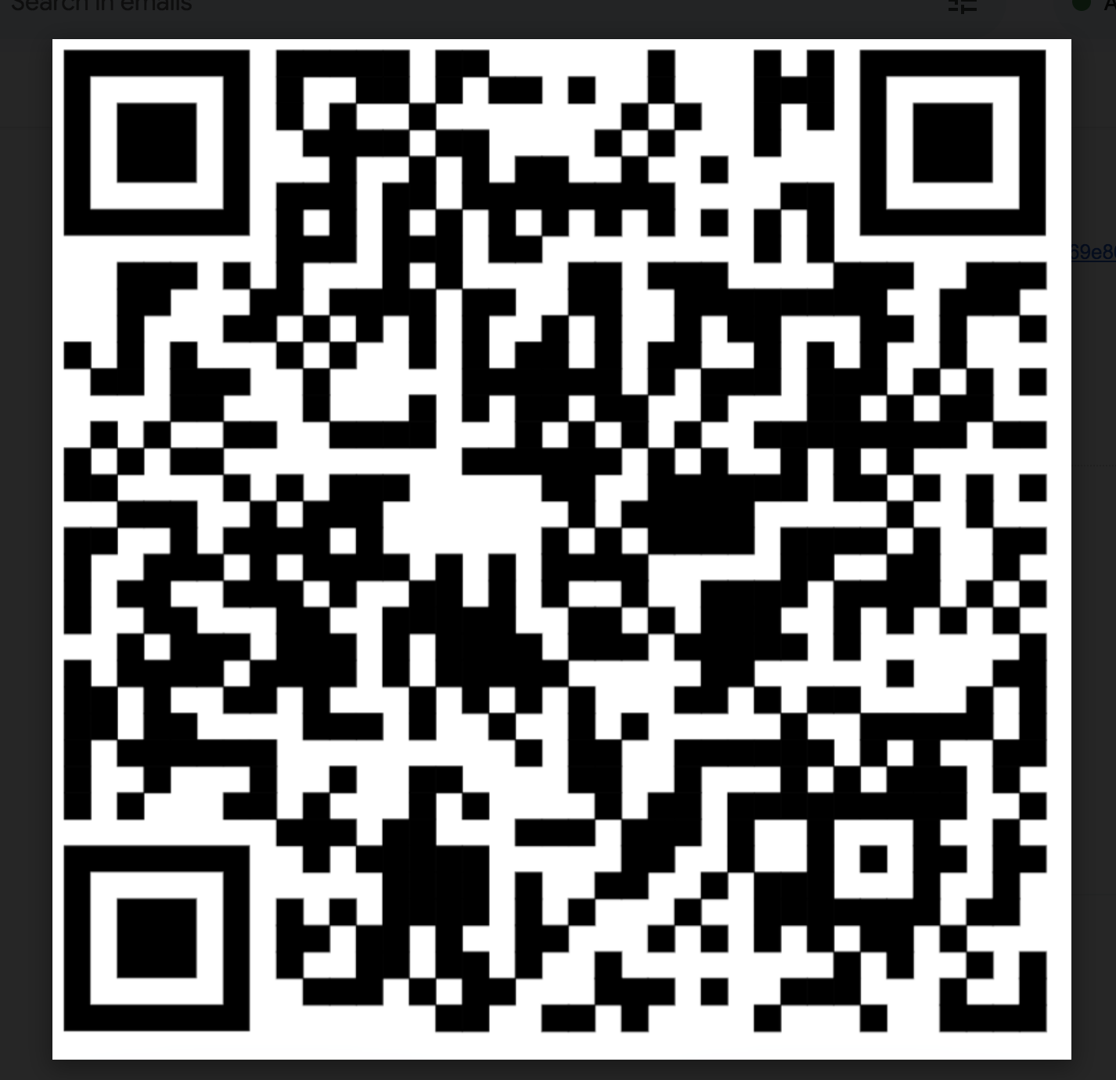
Feedback
https://forms.gle/w5RNKAaXq8UjMUa2A
The Peer Teaching Society is not liable for false or misleading information…

