Slide 1
2022/2023

Slide 2
Women’s Health 2022
Phase 3a Revision Session
Alfie Grocott
21/06/22

Slide 3
Aims and Objectives
Revise basic reproductive anatomy
Revise basic reproductive physiology
Overview of common pregnancy problems
Overview of common labour problems
Overview of common gynae presentations
The Peer Teaching Society is not liable for false or misleading information…

Slide 4
Contents
Obstetrics | Gynaecology
Anatomy | Menstrual Cycle
Normal Pregnancy | Contraception
Pregnancy Problems | Gynae Malignancy
Normal Labour | Common Presentations
Labour Problems
The Peer Teaching Society is not liable for false or misleading information…

Slide 5
Female Reproductive organs (1)
Vulva
Vagina
Cervix
Uterus
Fallopian Tubes
Ovaries
(Associated pelvic ligaments)
The Peer Teaching Society is not liable for false or misleading information…

Slide 6
Female Reproductive organs (2)
The Peer Teaching Society is not liable for false or misleading information…

Slide 7
Female reproductive organs (3)
The Peer Teaching Society is not liable for false or misleading information…

Slide 8
Early antral follicle
The Peer Teaching Society is not liable for false or misleading information…

Slide 9
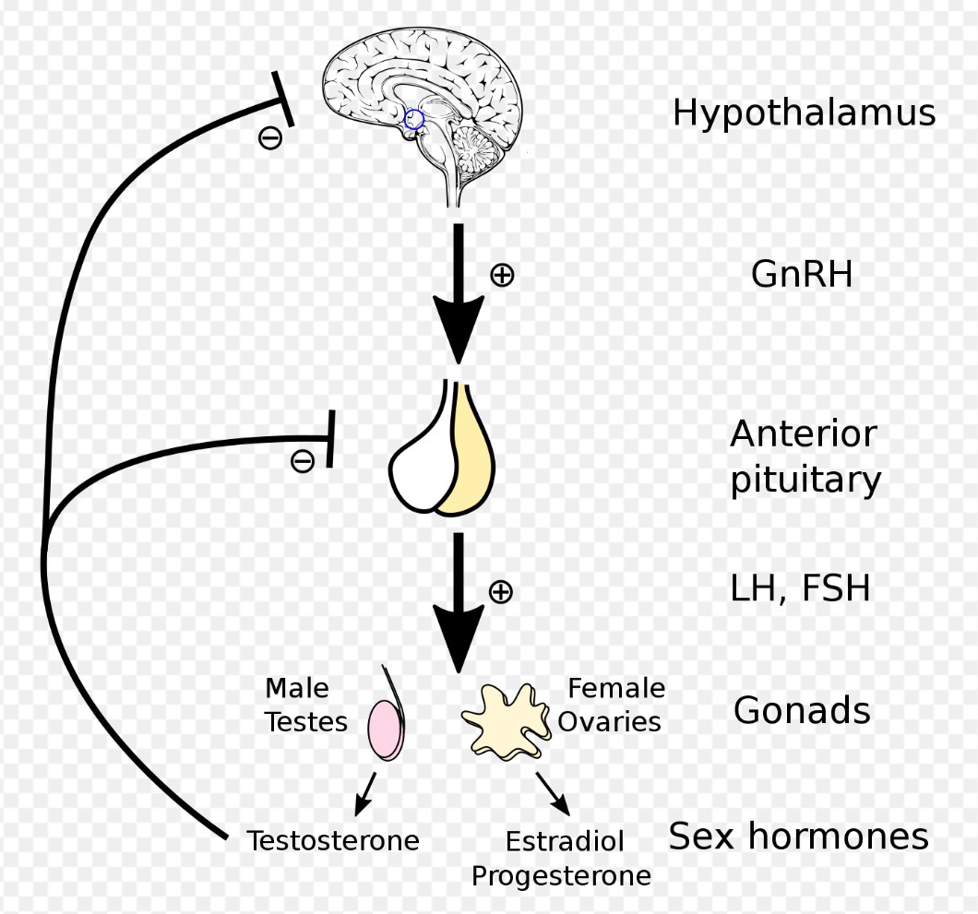
Menstrual cycle – HPG Axis
Pulsatile GnRH secretion stimulates LH and FSH secretion.
LH – theca cells – androgen production
FSH – granulosa cells – androgen conversion to oestrogen, inhibin secretion.
Oestrogen + Progesterone = negative feedback
High oestrogen alone = positive pituitary feedback.
Inhibin = FSH inhibition
The Peer Teaching Society is not liable for false or misleading information…

Slide 10
Menstrual cycle - ovarian
FOLLICULAR PHASE – Days 1-13
15-20 early antral follicles
Day 7 selection – dominant follicle
Day 13 LH surge due to high oestrogen alone – Graafian follicle (secondary oocyte)
Oestrogen rises throughout
OVULATION – Day 14
Graafian follicle ruptures and releases oocyte with antral fluid
Remaining follicular cells begin to produce progesterone, becoming corpus luteum.
LUTEAL PHASE – Days 15-28
Corpus luteum produces oestrogen, progesterone (Day 21 peak) and inhibin
Spontaneously regresses after 14 days, allowing LH / FSH to rise again.
The Peer Teaching Society is not liable for false or misleading information…

Slide 11
Menstrual cycle - Uterine
Period – Days 1-4
Progesterone withdrawal due to loss of corpus luteum
Proliferative Phase – Days 5-14
Endometrial proliferation*, spiral arterioles, secretory gland formation.
Under influence of oestrogen.
Secretory Phase – Days 15-28
Glands secrete glycogen, glycoproteins etc.
Myometrial contraction inhibited
Under influence of progesterone.
The Peer Teaching Society is not liable for false or misleading information…

Slide 12
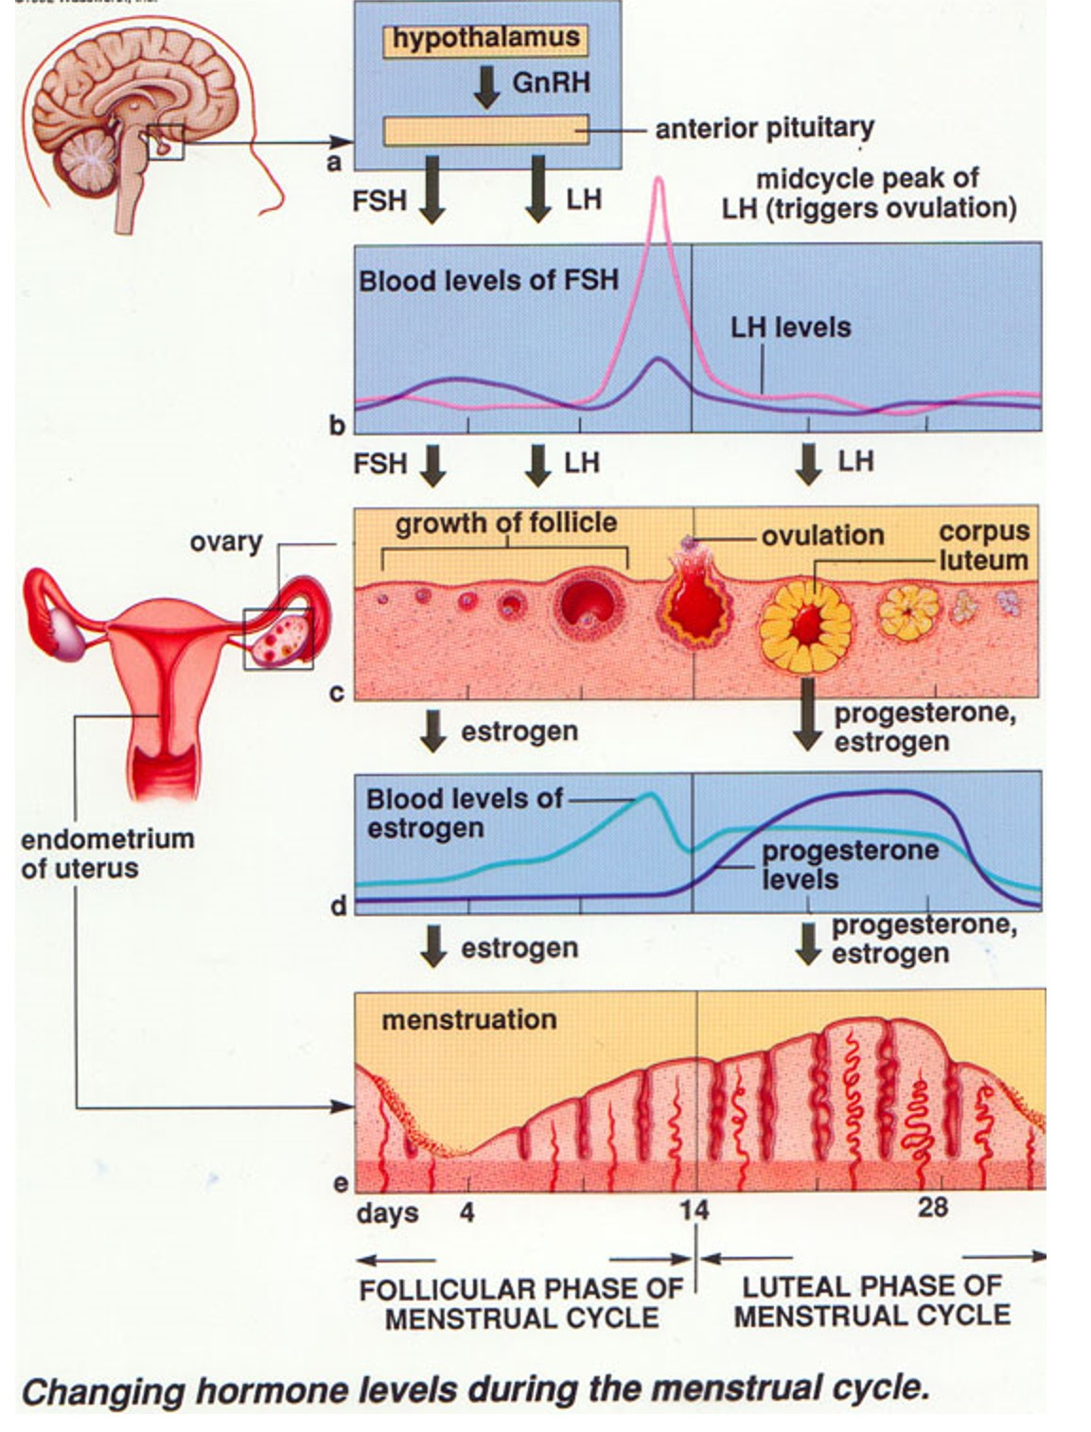
Summary
The Peer Teaching Society is not liable for false or misleading information…

Slide 13
Normal Pregnancy
Fertilisation and Implantation
Placenta
Foetal Development and Amniotic Fluid
Maternal Physiology
The Peer Teaching Society is not liable for false or misleading information…

Slide 14
Some terminology
Gestational Age: 1st day of LMP + 7 days + 9 months (280 days)
Term: 37+0 weeks
Gravidity: the number of times a woman has been pregnant, regardless of the outcome – includes current pregnancy.*
Parity: the number of times a woman has delivered a foetus with a gestational age greater than 24 weeks, regardless of outcome.*
Example - 30 weeks pregnant lady, with two children, 1 previous miscarriage at 9 weeks and 1 TOP at 11 weeks: G5 P2+2
Primigravida: pregnant for the first time (G1 P0)
Nulliparous: never given birth (G1 P0 or G0 P0)
Primiparous: has given birth once (e.g. G2 P1)
The Peer Teaching Society is not liable for false or misleading information…

Slide 15
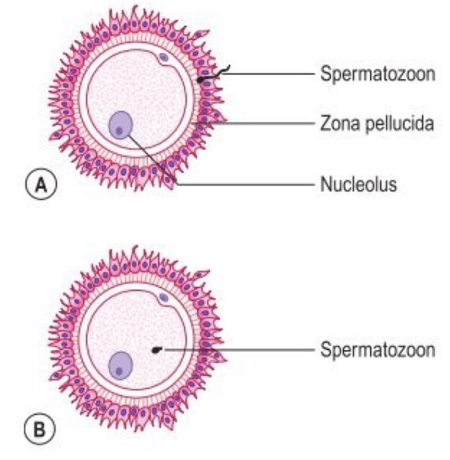
Fertilisation - Ampulla
Capacitation – final stage of sperm maturation
Acrosome reaction – lytic enzyme release, penetrates oocyte membrane
Cortical reaction – prevents multiple sperm from fertilising egg.
Syngamy – fusion of pronuclei
The Peer Teaching Society is not liable for false or misleading information…

Slide 16
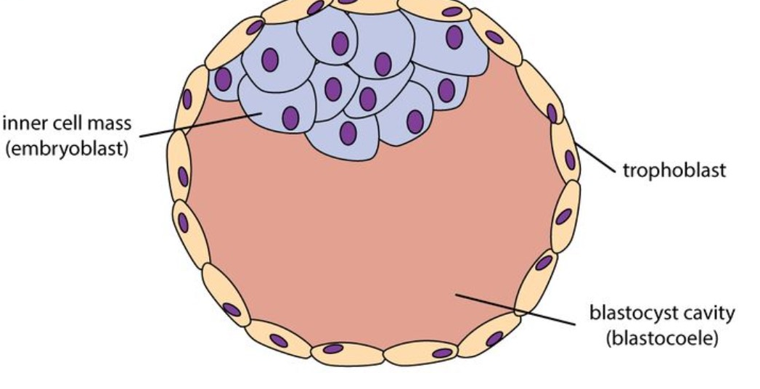
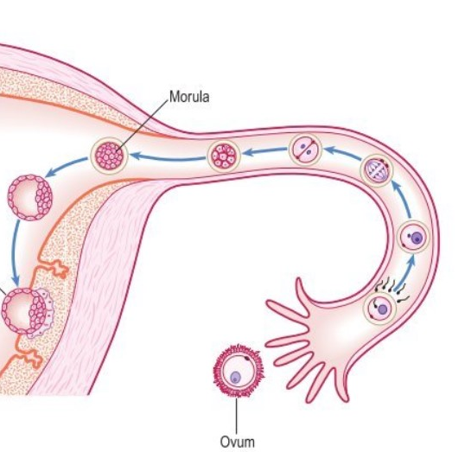
Implantation - Endometrium
Transport – approx. 36 hours, dividing conceptus transported down tube
Morula – 16 cell mass
Blastocyst:
Trophoblast
Blastocoel
Embryoblast
Implantation – Day 6
The Peer Teaching Society is not liable for false or misleading information…

Slide 17
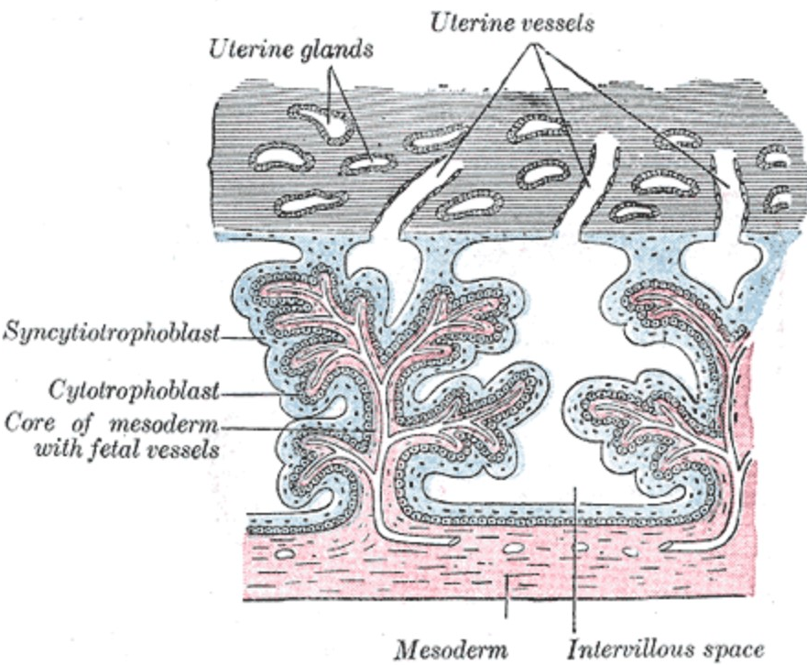
Placenta (1)
Begins to form directly after implantation (day 6-7)
Outer trophoblast cells invade into endometrium
By Day 14, the cells have invaded into maternal vessels, forming chorionic villi
By Day 21, foetal blood vessels have grown into the chorionic villi.
The Peer Teaching Society is not liable for false or misleading information…

Slide 18
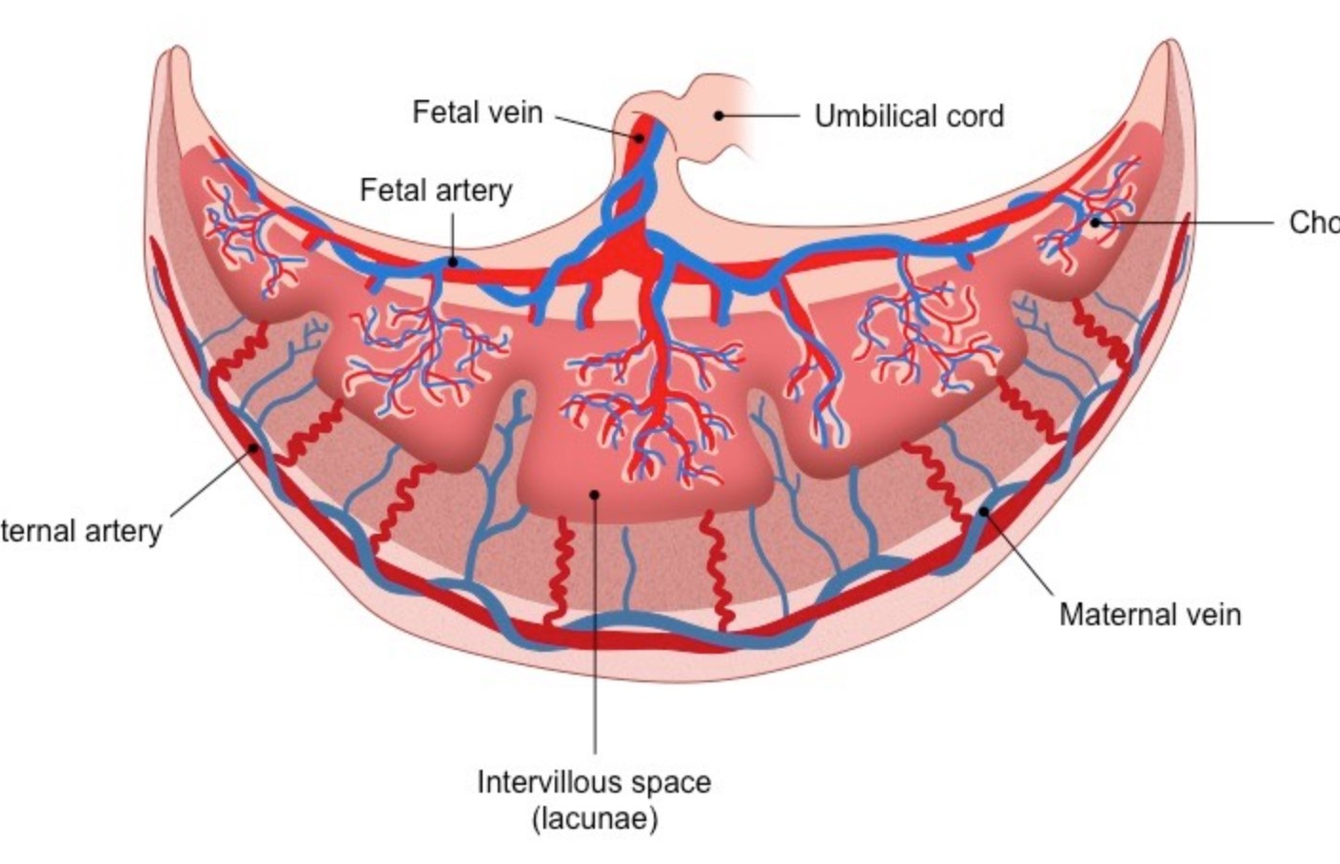
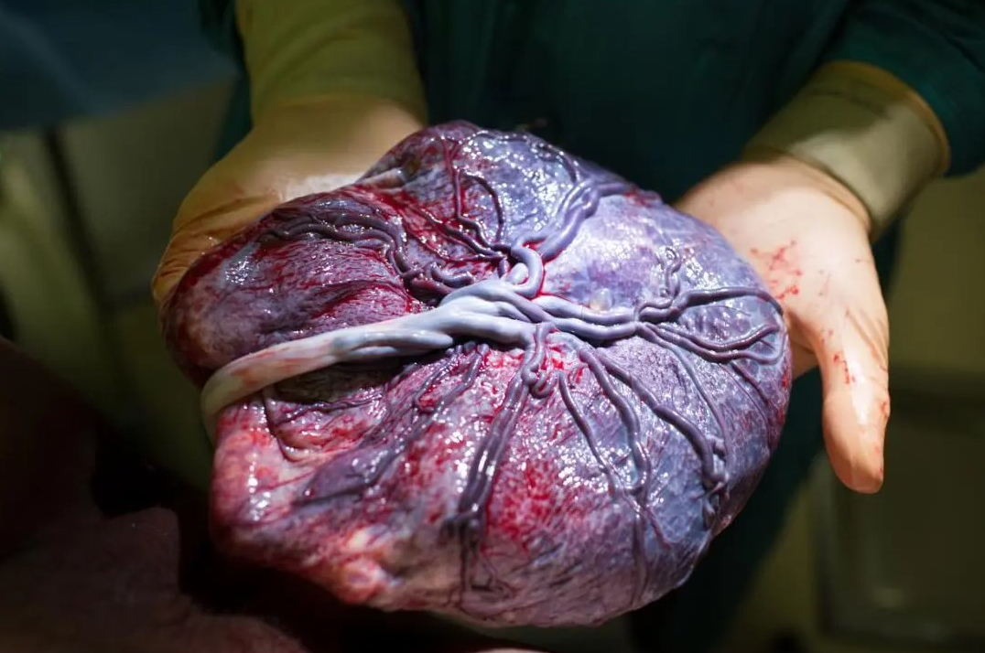
Placenta (2)
Gas Exchange – CO2 and O2
Nutrient Exchange – amino acids, fatty acids, glucose // urea and ammonia
Endocrine:
Oestrogen
Progesterone
Human Chorionic Gonadotrophin
Human Placental Lactogen
The Peer Teaching Society is not liable for false or misleading information…

Slide 19
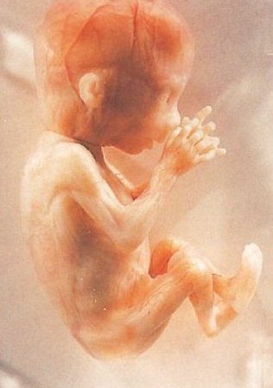
Foetal Development (1)
Weeks 1-10 Embryo: Little growth, but massive increase in cell numbers.
Neural tube closure at 4 weeks
Heartbeat at 4-5 weeks, definitive circulation by 11 weeks
Isolated limb movements at 10 weeks
Basically magic
Week 11 – Term, Foetus: Growth and further organ development
Week 12: CRL 56mm, weight 14g (pictured)
Week 16: CRL 122mm
Week 24: CRL 210mm
Surfactant Production 24 weeks
The Peer Teaching Society is not liable for false or misleading information…

Slide 20
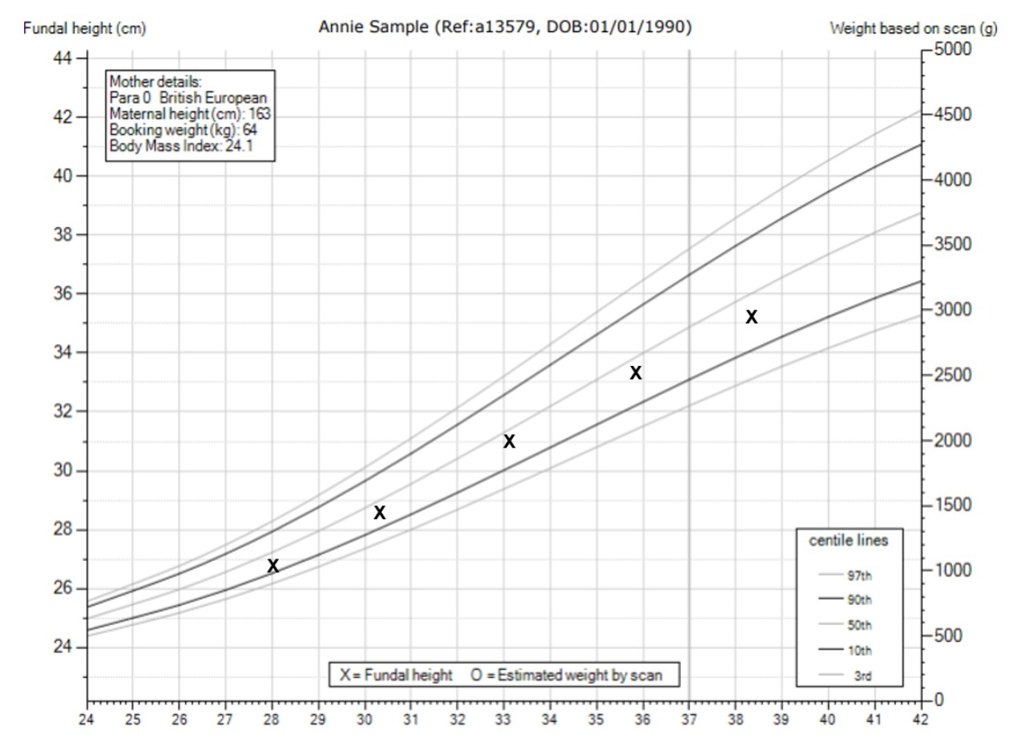
Foetal Development (2)
Customized growth chart
Height
Weight
Ethnicity
Parity
The Peer Teaching Society is not liable for false or misleading information…

Slide 21
Amniotic fluid
Amniotic cavity adjacent to epiblast of bilaminar disc from day 7.
Initially collection of extracellular fluid derived from maternal plasma.
Foetal renal function by 22 weeks.
Mainly foetal urine
Swallowed by foetus
Up to 1000ml at term (usually)
The Peer Teaching Society is not liable for false or misleading information…

Slide 22
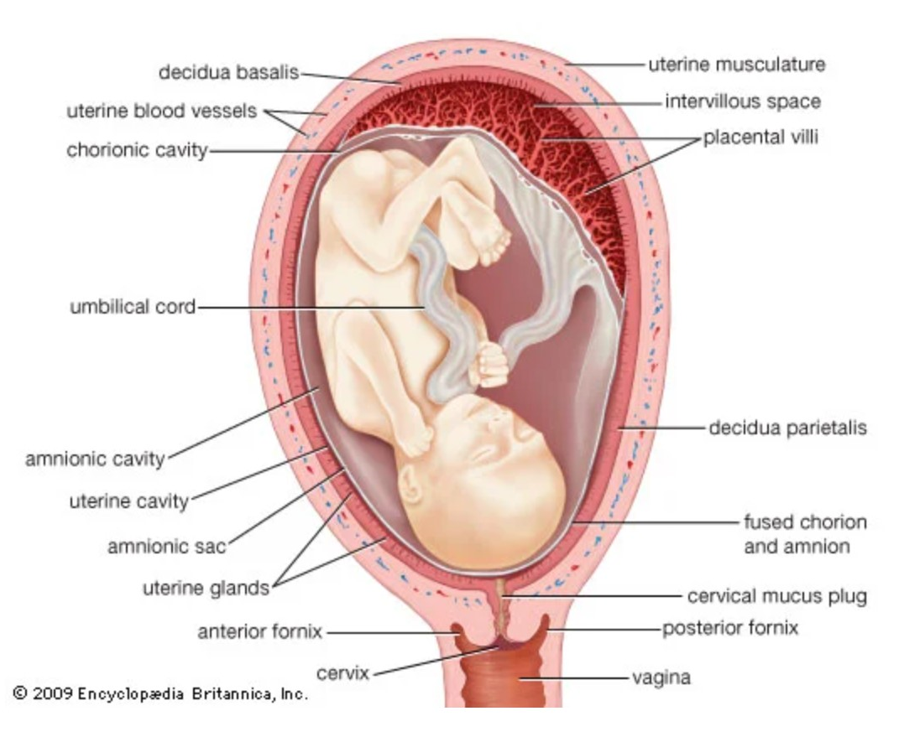
Maternal physiological changes
Immune suppression
Uterine hypertrophy – 60g non-pregnant, 1kg at term
500ml/min arterial flow at term
Cervical mucus plug (operculum)
Cardiovascular
Haematological
Respiratory – minute ventilation rises by 40%, low paCO2
Renal – sodium retention, increased renal clearance
Gastrointestinal – sphincter relaxation, delayed gastric emptying, dysmotility
Endocrine – prolactin and thyroid hormone increased, oestrogen and progesterone increase throughout.
The Peer Teaching Society is not liable for false or misleading information…

Slide 23
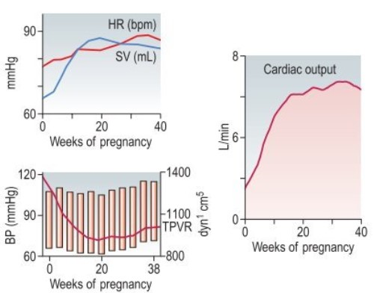
Cardiovascular changes
Cardiac output increases by 45% during first trimester
30% due to increased stroke volume (preload)
15% due to increased heart rate
Rises by a further 33% in labour.
MAP = CO * SVR
Offset by reduced peripheral vascular resistance
So systolic blood pressure only increases a little bit in third trimester.
The Peer Teaching Society is not liable for false or misleading information…

Slide 24
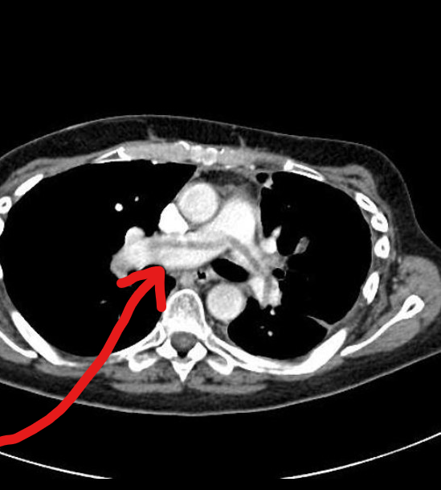
Haematological changes
INCREASED:
Plasma volume
Red cell mass
White cell count – neutrophilia
Clotting factors – survival mechanism
DECREASED:
Hb concentration – physiological anaemia
Platelet count
Fibrinolysis
The Peer Teaching Society is not liable for false or misleading information…

Slide 25
Pregnancy problems
Pre-eclampsia
Antepartum haemorrhage
Obstetric cholestasis
Gestational diabetes
The Peer Teaching Society is not liable for false or misleading information…

Slide 26
Pre-eclampsia (1)
Definition: new onset hypertension and proteinuria (2+) after 20 weeks gestation // hypertension plus systemic effect.
Pathogenesis: complex, due to abnormal invasion of trophoblast into maternal spiral arterioles
Pathophysiology: systemic vasoconstriction = multisystem damage: liver, kidneys, CNS, haematological, placental insufficiency.
Risk Factors: nulliparity, twin pregnancy, previous hx, family hx, obesity, age 40+,etc.
Signs and Symptoms: headache, oedema, RFM, hyperreflexia
The Peer Teaching Society is not liable for false or misleading information…

Slide 27
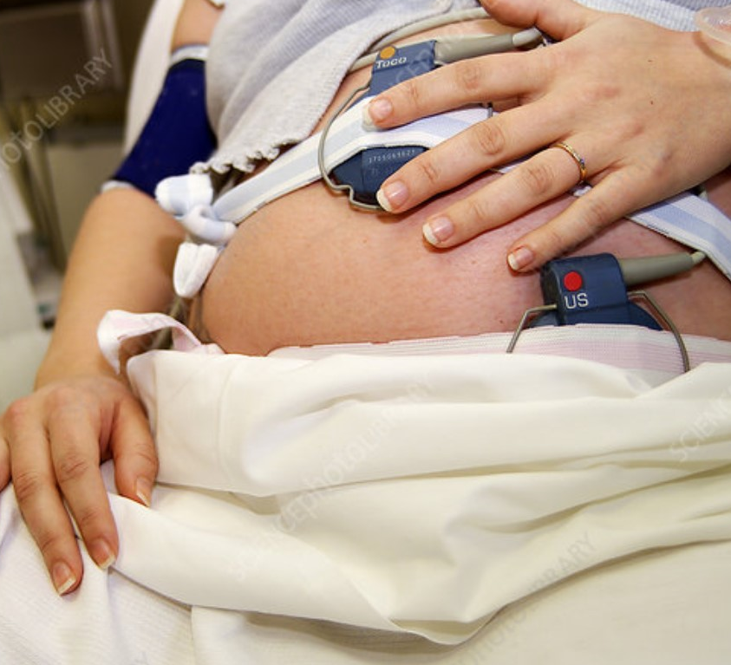
Pre-eclampsia (2)
Investigations 1: PLGF, urinalysis, blood pressure, U+Es, LFTs, FBC
Investigations 2: 2-weekly CTG, umbilical artery Doppler, USS foetus.
Management 1: labetalol / nifedipine / methyldopa
Management 2: delivery (<34 weeks, give MgSO4 and betamethasone / dexamethasone)
Management 3: if high risk, give aspirin from 12 weeks
The Peer Teaching Society is not liable for false or misleading information…

Slide 28
Pre-eclampsia complications
Eclampsia:
Tonic-clonic seizures in presence of pre-eclampsia
Management: delivery, magnesium sulfate
HELLP syndrome:
Haemolysis, Elevated Liver enzymes, Low Platelets
Management: delivery
DIC:
Management: platelet and FFP infusion
Intrauterine Growth Restriction:
Below 10th centile
Intrauterine Foetal Death:
Placental infarction and insufficiency
Renal Failure
Acute Liver Failure
Stroke
Heart Failure
The Peer Teaching Society is not liable for false or misleading information…

Slide 29
Antepartum haemorrhage
Definition: PV bleed after 24 weeks gestation
Causes:
Placental Abruption
Placenta Praevia
Vasa Praevia
Cervical Ectropion
50% unexplained
The Peer Teaching Society is not liable for false or misleading information…

Slide 30
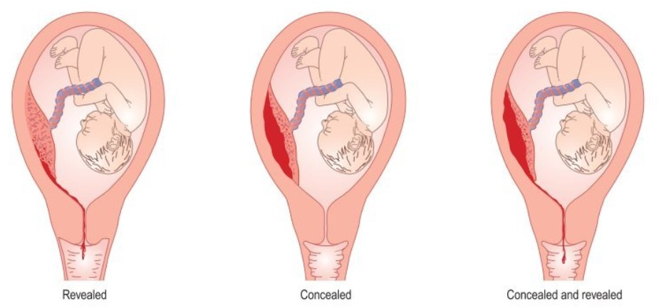
Placental abruption
Definition: premature separation of placental bed
Presentation:
Acute abdominal pain (but not always)
Contractions
Antepartum haemorrhage (but not always)
“Woody” uterus on palpation
Investigations:
Bloods, coagulation screen, USS foetus, CTG monitoring
Management:
Expedite delivery (induction or C-Section, dependant on foetal condition).
The Peer Teaching Society is not liable for false or misleading information…

Slide 31
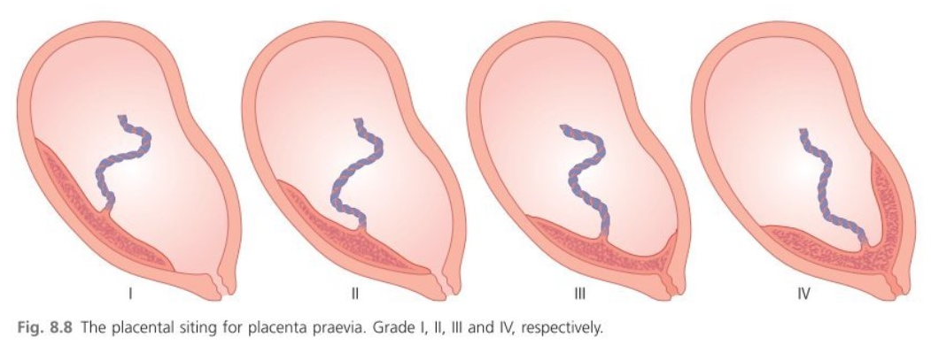
Placenta Praevia
Definition: placenta lying in lower segment of the uterus – Grades 1-IV
Presentation: painless antepartum haemorrhage, soft uterus
Investigations: bloods, coag screen, USS foetus, CTG monitoring (i.e. APH investigations).
Low-lying placenta should be detected on routine 20 week anomaly scan
Follow-up TVUSS at 32 weeks
Management: elective C-section
The Peer Teaching Society is not liable for false or misleading information…

Slide 32
Anatomy of the pelvis
The Peer Teaching Society is not liable for false or misleading information…
Notes:
Pelvic girdle is made up of sacrum, coccyx and 2x innominate bones – the ilium, ischium and pubis
Acetabulum is formed from where the three parts of the innominate bone meet – this is where the femoral head articulates.

Slide 33
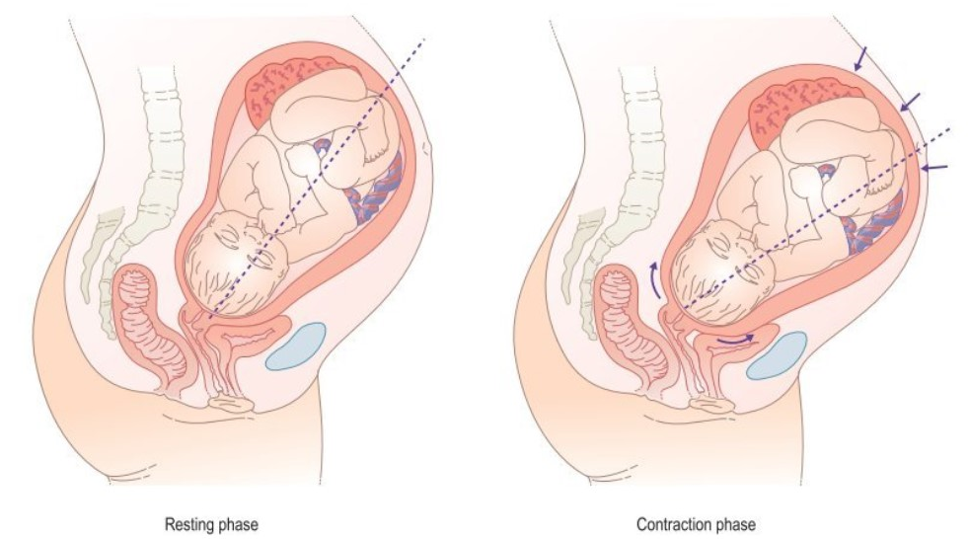
Normal Labour (1)
Signs of Labour:
Progressive contractions (3-5 in 10)
Bloody show
Ruptured membranes (waters break)
First Stage:
Latent: fully effaced, 3cm dilated cervix – 6-8 hours
Active: 3cm – 10cm dilated – 0.5-1cm per hour
Second Stage:
Fully dilated – baby delivered – up to 3 hours pri, up to 2 hours multip
Third Stage:
Baby delivered – placenta delivered – up to 30 minutes, assisted with syntocinon IM and gentle cord traction.
The Peer Teaching Society is not liable for false or misleading information…
Notes:
Progesterone withdrawal, oestrogen and prostaglandin upregulation – probably due to placental corticotrophin-releasing hormone
Increase in connexin 3 -> increased myocyte connectivity and electrical excitability

Slide 34
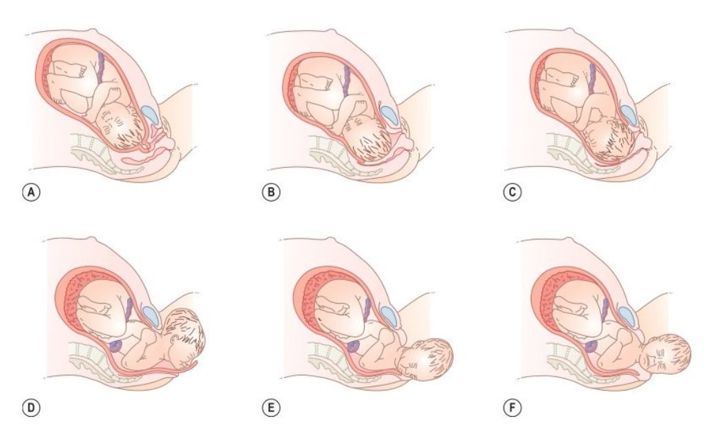
Normal Labour (2)
Descent and engagement
Flexion – narrowest diameter
Internal Rotation of head into OA
Extension – crowning
Restitution – head aligns with shoulders
External Rotation – shoulders rotate
Delivery of Shoulders – gentle traction
The Peer Teaching Society is not liable for false or misleading information…

Slide 35
Failure to progress
Definition: insufficient rate of dilatation / foetal descent.
Causes:
Power – hypotonic uterine activity (45s, 3-5 in 10)
Passage – pelvic dimensions (inlet / outlet)
Passenger – position (rotation), attitude (flexion) and head size
Investigations: VE, foetal monitoring on CTG
Management:
Augmentation of labour – ARM, syntocinon infusion
Instrumental delivery – Forceps or Ventouse
Caesarean Section
The Peer Teaching Society is not liable for false or misleading information…

Slide 36
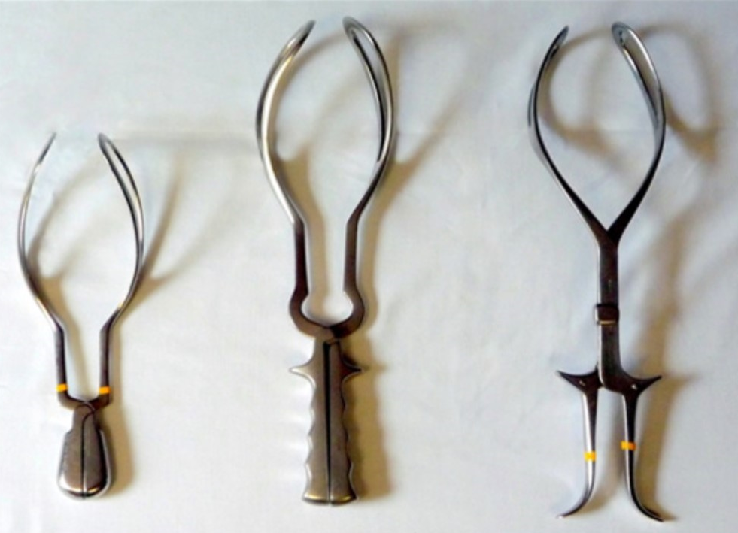
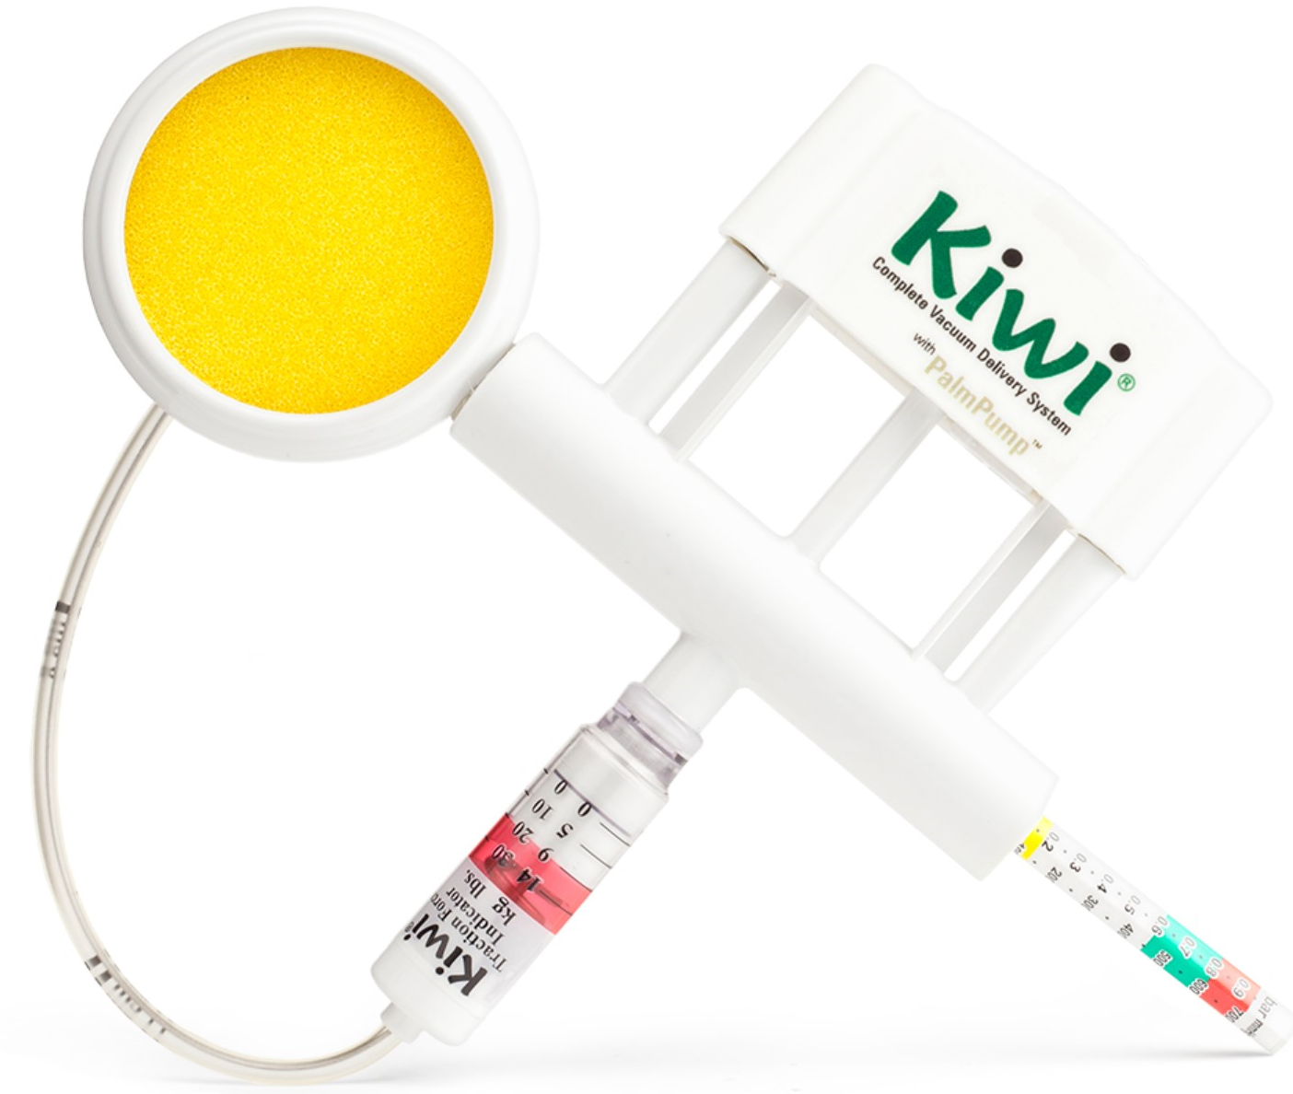
Instrumental delivery
Forceps:
Neville Barnes (head 1/5 palpable in pelvis)
Wrigley’s (outlet, scalp visible)
Rotational (malposition)
Risks: vaginal trauma, facial nerve palsy, cranial trauma
Ventouse:
Kiwi
Risks: retinal haemorrhage, cephalohaematoma
The Peer Teaching Society is not liable for false or misleading information…

Slide 37
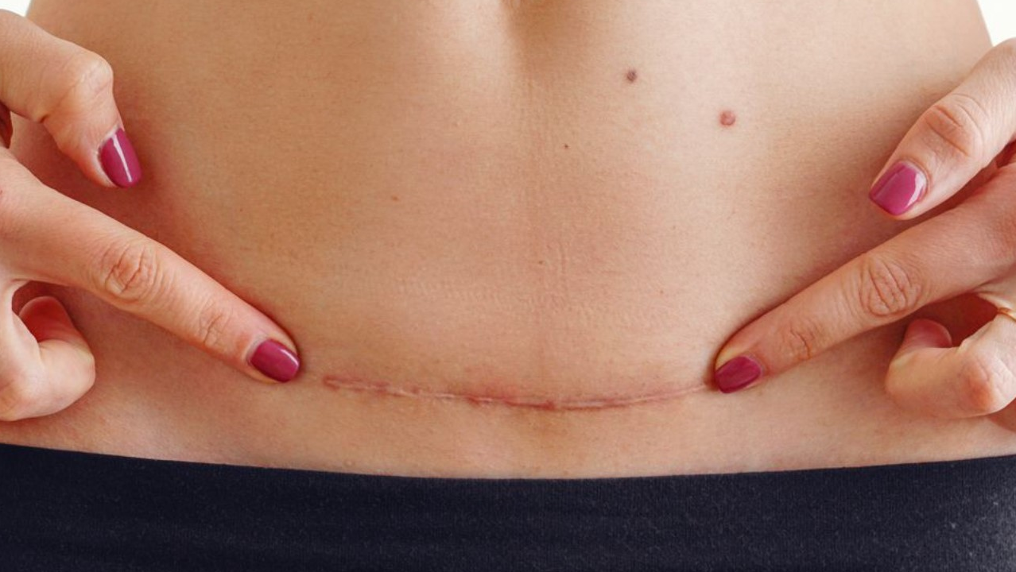
Caesarean section
Category 1 – 4, ranging from “immediate threat to life” to “elective.”
30-35% of all births.
Foetal compromise, breech, placenta praevia, maternal request, plus many others.
Skin (sewn)
Camper’s fascia
Scarpa’s fascia
Rectus sheath (sewn)
Separate rectus abdominus
Parietal peritoneum
Uterus (sewn)
The Peer Teaching Society is not liable for false or misleading information…

Slide 38
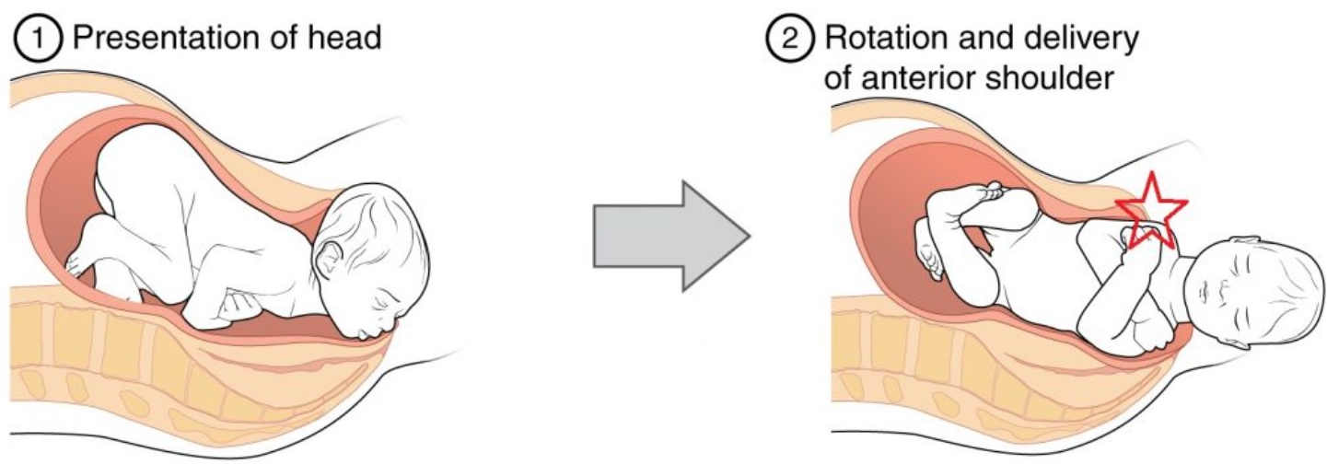
Shoulder dystocia (1)
Definition: normal gentle axial traction insufficient to deliver shoulders after head is born.
Incidence: 1:150 births
Mechanism: anterior shoulder impacted behind pubic symphysis // posterior shoulder behind sacral promontory (rare)
Risk Factors: previous hx, macrosomia (big baby), diabetes (causes macrosomia), high maternal BMI.
Complications: brachial plexus injury, cerebral palsy, perinatal mortality, PPH.
Recognition: turtle neck, failure of restitution, difficulty delivering head / chin.
Morbidity: low chance of HIE if delivered in less than 5 minutes.
The Peer Teaching Society is not liable for false or misleading information…

Slide 39
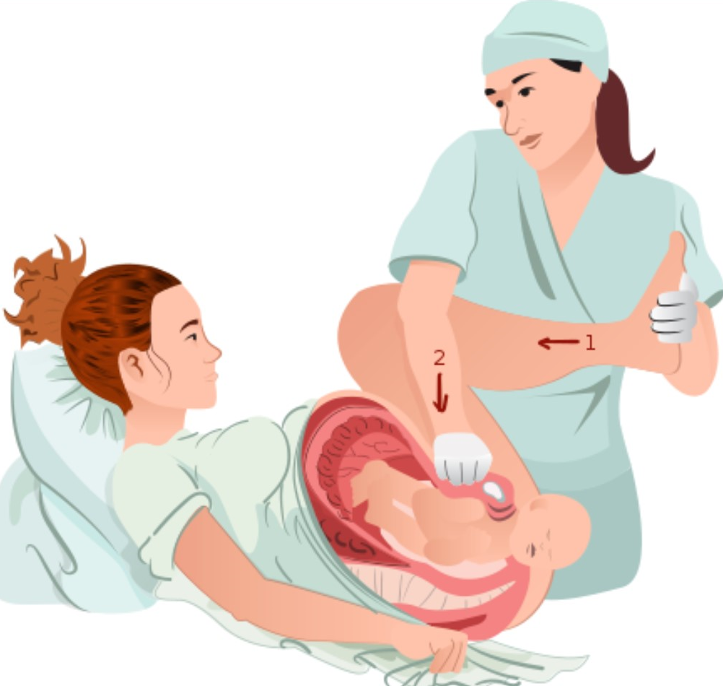
Shoulder dystocia (2)
Management 1: call for help!
Management 2: tell mum to stop pushing, lie flat on bed
Management 3: McRobert’s + suprapubic pressure + axial traction (90%)
Management 4: internal manoeuvres / deliver posterior arm
Management 5: all fours, repeat
Management 6: Third Line (cleidotomy, Zanvanelli, symphysiotomy)
The Peer Teaching Society is not liable for false or misleading information…

Slide 40
Postpartum haemorrhage
Primary: 500ml loss within 24 hours of delivery
Secondary: 500ml loss 24hrs – 12 weeks post delivery
500-1000ml = minor, 1000-1500 = major, 1500+ = massive obstetric haemorrhage
THE FOUR Ts
Tone – atonic uterus (prolonged labour, macrosomia, twins)
Trauma – genital tract injury
Tissue – retained placenta / membranes
Thrombin – coagulopathy e.g. DIC in pre-eclampsia
Management: dependent on cause
Fundal massage + syntocinon + ergometrine
Resuscitation: fluids, oxygen, blood products.
The Peer Teaching Society is not liable for false or misleading information…

Slide 41
gynaecology
The Peer Teaching Society is not liable for false or misleading information…

Slide 42
Contraception (1)
Combined Pill (COCP) | Progesterone Only Pill (POP)
Oestrogen and Progestogen | Progestogen e.g. levonorgestrel
Inhibits ovulation (LH, FSH, GnRH) | Thickens cervical mucus (barrier)
Take 21:7 | Take daily, 3 hour window*
VTE, stroke risk increased | Menstrual irregularities increased
Ovarian, endometrial cancer risk reduced
The Peer Teaching Society is not liable for false or misleading information…

Slide 43
Contraception (2) - LARCs
Mirena IUS | Copper IUD | Implant | Depot
Local progesterone | Copper | Systemic progesterone | Systemic Progesterone
Suppresses endometrial proliferation | Inhibits fertilisation + implantation | Inhibits ovulation | Inhibits ovulation
5 years | 5-10 years | 3-4 years | 10-14 weeks
Menstrual benefits | Emergency contraception | Most effective | Most weight gain
The Peer Teaching Society is not liable for false or misleading information…

Slide 44
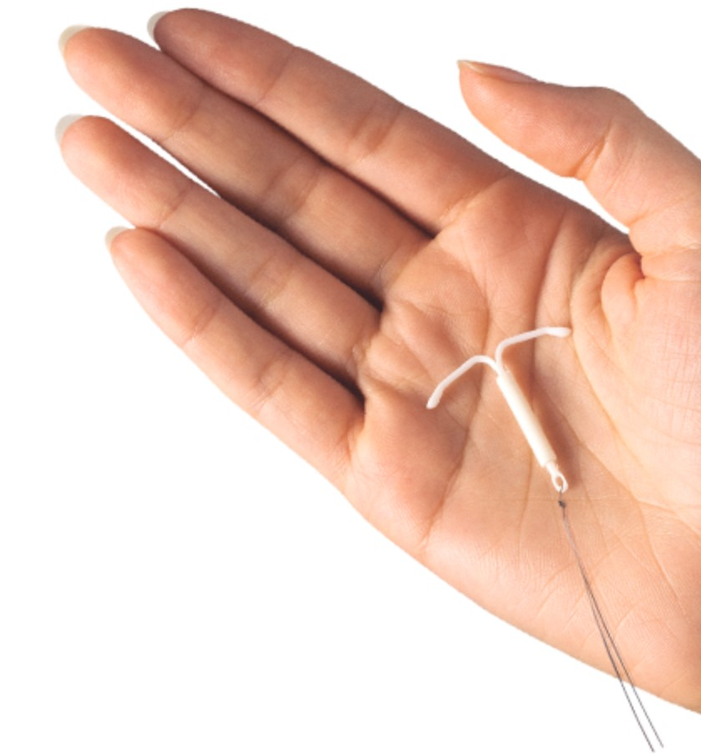
Probably the right answer
The Peer Teaching Society is not liable for false or misleading information…

Slide 45
Malignancy
Endometrial
Ovarian
Cervical
The Peer Teaching Society is not liable for false or misleading information…

Slide 46
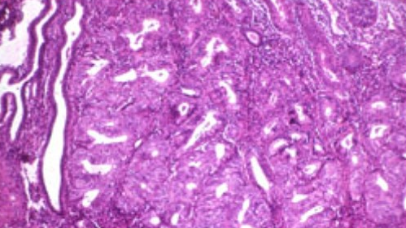
Endometrial cancer
Commonest gynae cancer
Postmenopausal women
Adenocarcinoma of the endometrium
Risk Factors: obesity, unopposed oestrogen (chronic anovulation), tamoxifen
Presentation: postmenopausal bleeding means 2 week wait – endometrial cancer until proven otherwise!
Investigations: TVUSS (5mm thickness), endometrial biopsy
Management: Total Hysterectomy + Bilateral Salpingo-oophorectomy +/- Brachytherapy +/- Carboplatin / Paclitaxel
The Peer Teaching Society is not liable for false or misleading information…

Slide 47
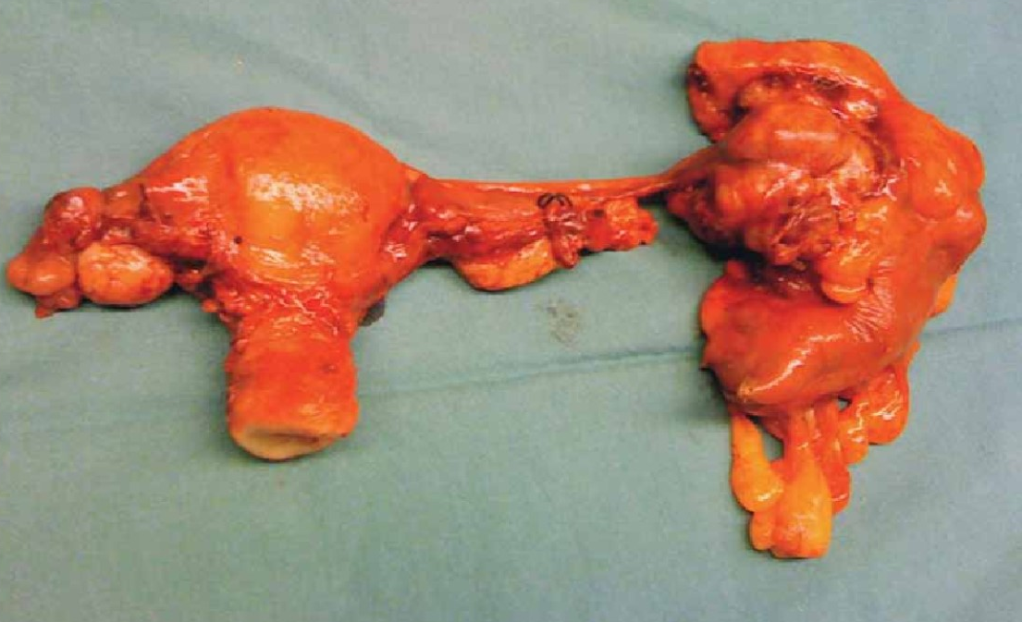
Ovarian cancer
Postmenopausal women
Adenocarcinoma (germinal epithelium), roughly 90%
Risk Factors: BRCA, family hx, never used COCP
Presentation: pelvic mass, ascites, IBS symptoms, urinary symptoms.
Investigations: CA125 (>35), USS Abdomen
Management: Total Abdominal Hysterectomy + BSO + Carboplatin / Paclitaxel
The Peer Teaching Society is not liable for false or misleading information…

Slide 48
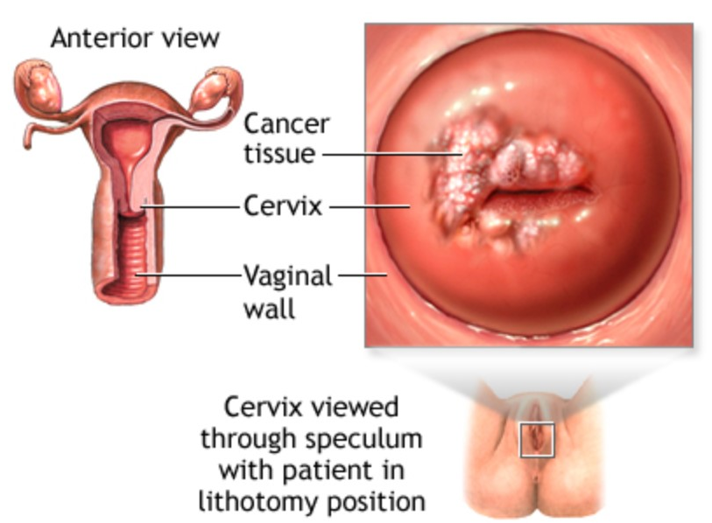
Cervical cancer
HPV-related (Strains 16 and 18) – preventable by vaccination
Peak incidence aged 30-45
Squamous cell carcinoma of ectocervix (mostly)
Risk Factors: hr-HPV infection
Presentation: asymptomatic finding, postcoital bleeding, intermenstrual bleeding, abnormal discharge
Screening: 25-49 3-yearly, 50-64 5-yearly. HPV + LBC +/- Colposcopy and Biopsy*
Investigations: Speculum examination + screening tests
Management: Dependent on stage – cone biopsy for CIN, hysterectomy + cisplatin + radiotherapy
The Peer Teaching Society is not liable for false or misleading information…

Slide 49
Common gynae presentations 1: Dysmenorrhea
Liz, 26 years old, G2 P2
Progressively more painful periods, with pain in between
Dyspareunia
Missing work when on her period
Ibuprofen doesn’t work any more.
What are your differentials? What do you do next?
The Peer Teaching Society is not liable for false or misleading information…

Slide 50
Dysmenorrhea
Definition: very painful periods
Top Differentials:
Primary Dysmenorrhea: 6-12 months after menarche, no specific cause identified
Endometriosis
Adenomyosis
Fibroids
Pelvic Inflammatory Disease
Full gynae and obstetric history
Abdominal examination – masses?
Pelvic examination – speculum
Consider referral.
The Peer Teaching Society is not liable for false or misleading information…

Slide 51
Endometriosis
Definition: Presence of endometrial stroma and glands outside of the uterine cavity.
Pathophysiology: nobody really knows – maybe retrograde menstruation
Presentation: Dysmenorrhea, cyclical pelvic pain, subfertility.
Investigations: TVUSS, Laparoscopy is gold standard
Management 1: COCP / Mirena / Medroxyprogesterone
Management II: Endometriosis surgery
The Peer Teaching Society is not liable for false or misleading information…

Slide 52
Common gynae presentations 2: menorrhagia
Anne, 40 years old, G3 P2+1
Periods getting heavier
Longer duration
Changing pad more frequently
Feeling tired and lethargic
What are your differentials? What do you do next?
The Peer Teaching Society is not liable for false or misleading information…

Slide 53
menorrhagia
Definition: technically 80ml loss per cycle / period lasting more than 7 days
Average loss 30-40ml per cycle
In practice, diagnosed by the history.
Top Differentials:
Dysfunctional Uterine Bleeding (50%) – no secondary cause identified
Fibroids
Endometriosis
Hypothyroidism
Coagulopathy
Full gynaecological and obstetric history
Abdominal examination - masses
Bimanual examination
Full Blood Count
Treat or Refer for TVUSS / Hysteroscopy
The Peer Teaching Society is not liable for false or misleading information…

Slide 54
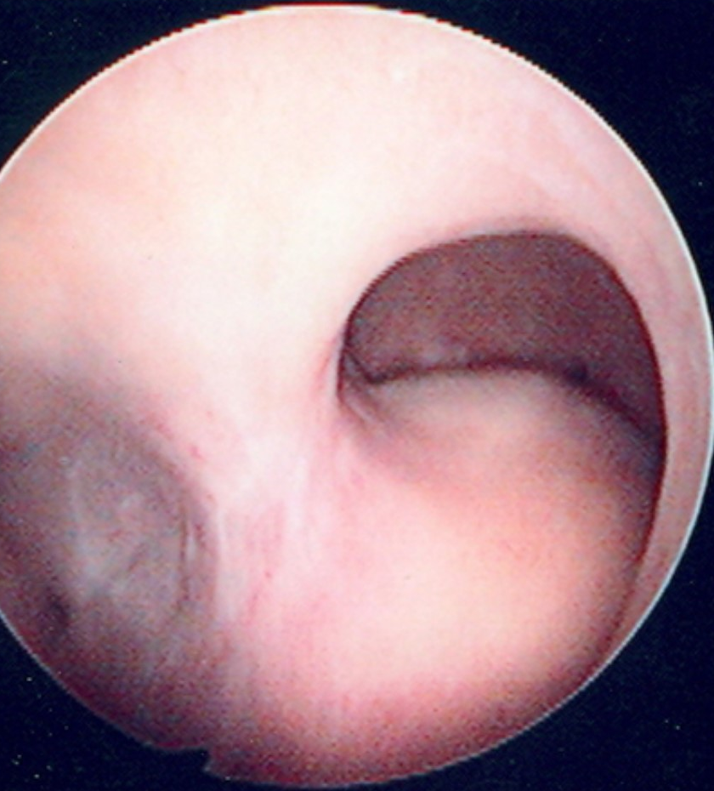
fibroids
Definition: benign neoplasia of uterine smooth muscle (leiomyomata)
Risk Factors: Black ethnicity, aged 40-50, obesity
Presentation: menorrhagia, pelvic pressure, bloating, dysmenorrhea
Investigations: TVUSS, hysteroscopy
Management 1: Mirena IUS / COCP, tranexamic acid / mefenamic acid
Management 2: Leuprorelin (GnRH analogue) / mifepristone (anti-progestogen)
Management 3: Myomectomy (fertility-preserving) / hysterectomy
The Peer Teaching Society is not liable for false or misleading information…

Slide 55
Common gynae presentations 3: oligomenorrhea
Camilla, 30 years old, G0P0
Trying to conceive for 12 months
Irregular periods – cycles last 1-6 months
What are your differentials? What do you do next?
The Peer Teaching Society is not liable for false or misleading information…

Slide 56
Oligomenorrhea and amenorrhea (1)
Primary amenorrhea – not started periods at 13 with no secondary sexual characteristics or not started periods at 15 with normal secondary sexual characteristics
Secondary amenorrhea – no periods for 3 consecutive cycles
Oligomenorrhea – infrequent periods
Top Differentials:
Functional Hypothalamic Amenorrhea – stress, exercise, weight loss, eating disorders
Polycystic Ovarian Disease (PCOS)
Hyperthyroidism
Perimenopause, + many others
The Peer Teaching Society is not liable for false or misleading information…

Slide 57
Oligomenorrhea and amenorrhea - investigations
Full gynae and obstetric history
Measure height and weight – PCOS, FHA
FSH and LH
Serum testosterone
Prolactin
TSH
The Peer Teaching Society is not liable for false or misleading information…

Slide 58
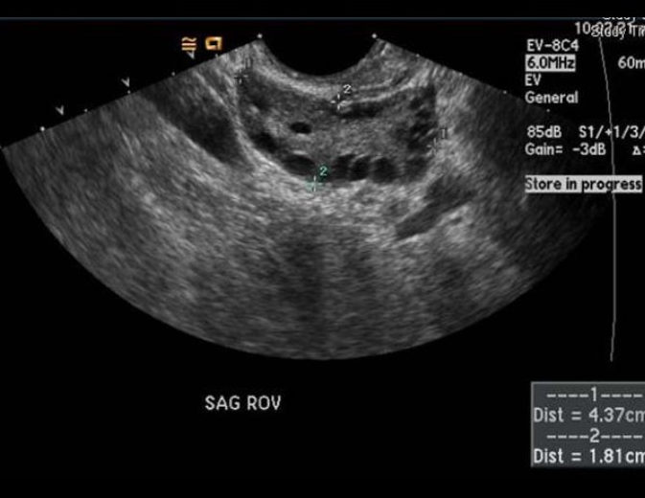
Polycystic ovarian syndrome
Definition: 2 out of 3 Rotterdam Criteria:
Oligomenorrhea
Features of hyperandrogenism
Polycystic ovaries
Pathophysiology:
Abnormal ovarian steroidogenesis leads to raised androgens
Increased GnRH frequency // high LH, low FSH // high androgens, low aromatase // high androgens, low oestrogen // no LH surge // no ovulation, cyst of antral fluid remains.
Insulin resistance // mitogenic on ovaries + adrenals // high androgens
Presentation: oligomenorrhea, subfertility, acne, hirsutism
Investigations: FSH/LH, SHBG, testosterone, TFTs, prolactin, USS
Management: COCP // metformin + clomiphene
The Peer Teaching Society is not liable for false or misleading information…

Slide 59
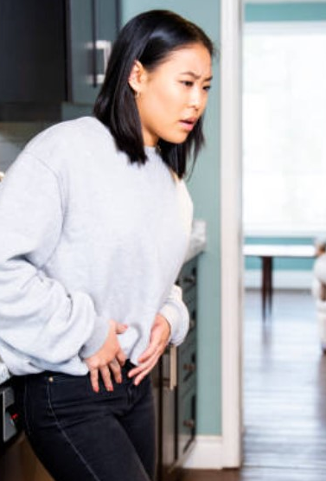
Common gynae presentations 4: acute lower abdo pain
Diana, 21 years old, G0 P0
Presents to A+E
Sudden onset right iliac fossa pain
Sexually active, 7 weeks since LMP
Previous PID
On the COCP
What are your differentials? What do you do next?
The Peer Teaching Society is not liable for false or misleading information…

Slide 60
Acute Lower aBDO pain
Differentials:
Appendicitis
Ectopic Pregnancy
Ovarian Torsion
Miscarriage
Cyst Rupture
PID / tubal abscess
Plan:
Urine Pregnancy Test
TV USS
Serial serum beta-hCG if no pregnancy found in positive UPT
i.e. ectopic until proven otherwise
The Peer Teaching Society is not liable for false or misleading information…

Slide 61
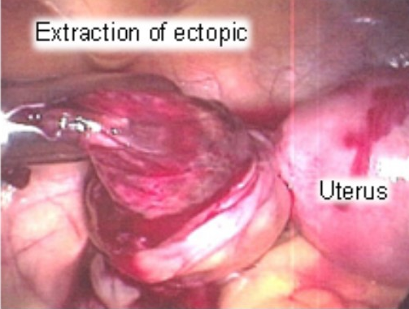
Ectopic pregnancy
Definition: implantation of conceptus anywhere outside of the uterine cavity (usually tubal)
Site: usually ampulla of fallopian tube; isthmus causes most bleeding.
Presentation: typically 6-8 weeks gestational age. Acute iliac fossa pain, tenderness / guarding, PV bleed.
Investigations: pregnancy test, TV USS, serial beta-hCG if pregnancy not found.
Management 1: unruptured – methotrexate or laparoscopic salpingectomy / salpingotomy
Management 2: ruptured – laparoscopic salpingectomy / salpingotomy + resuscitation +/- post-op methotrexate*
The Peer Teaching Society is not liable for false or misleading information…

Slide 62
Any questions?

Slide 63
A big list of everything not covered
Breast cancer + other breast disease.
Menopause
Miscarriage
Termination of Pregnancy
Gestational Diabetes
Obstetric Cholestasis
Obstetric Examination
Intrapartum Surveillance
Preterm Labour
Premature Rupture of Membranes
Rhesus Incompatibility
Intrauterine Growth Restriction
Induction of Labour
Tears
Hyperemesis
Postnatal Depression
Pelvic Inflammatory Disease
Infertility
Incontinence
Pelvic Organ Prolapse
The Peer Teaching Society is not liable for false or misleading information…

Slide 64
sources
Essential Obstetrics and Gynaecology – Symonds and Arulkumaran
Embryology at a Glance - Webster
teachmephysiology.com
teachmeanatomy.com
teachmeobgyn.com
http://medcell.med.yale.edu/histology/ovary_follicle.php
radiopedia.org
RCOG e-learning
RCOG green-top guidelines
BMJ Bestpractice
NICE CKS
Witchel S, Oberfield S, Peña A. Polycystic Ovary Syndrome: Pathophysiology, Presentation, and Treatment With Emphasis on Adolescent Girls. Journal of the Endocrine Society. 2019;3(8):1545-1573.

Slide 65
Feedback
https://forms.gle/cgcCFcUL6FuXtTcy6
The Peer Teaching Society is not liable for false or misleading information…

Slide 67
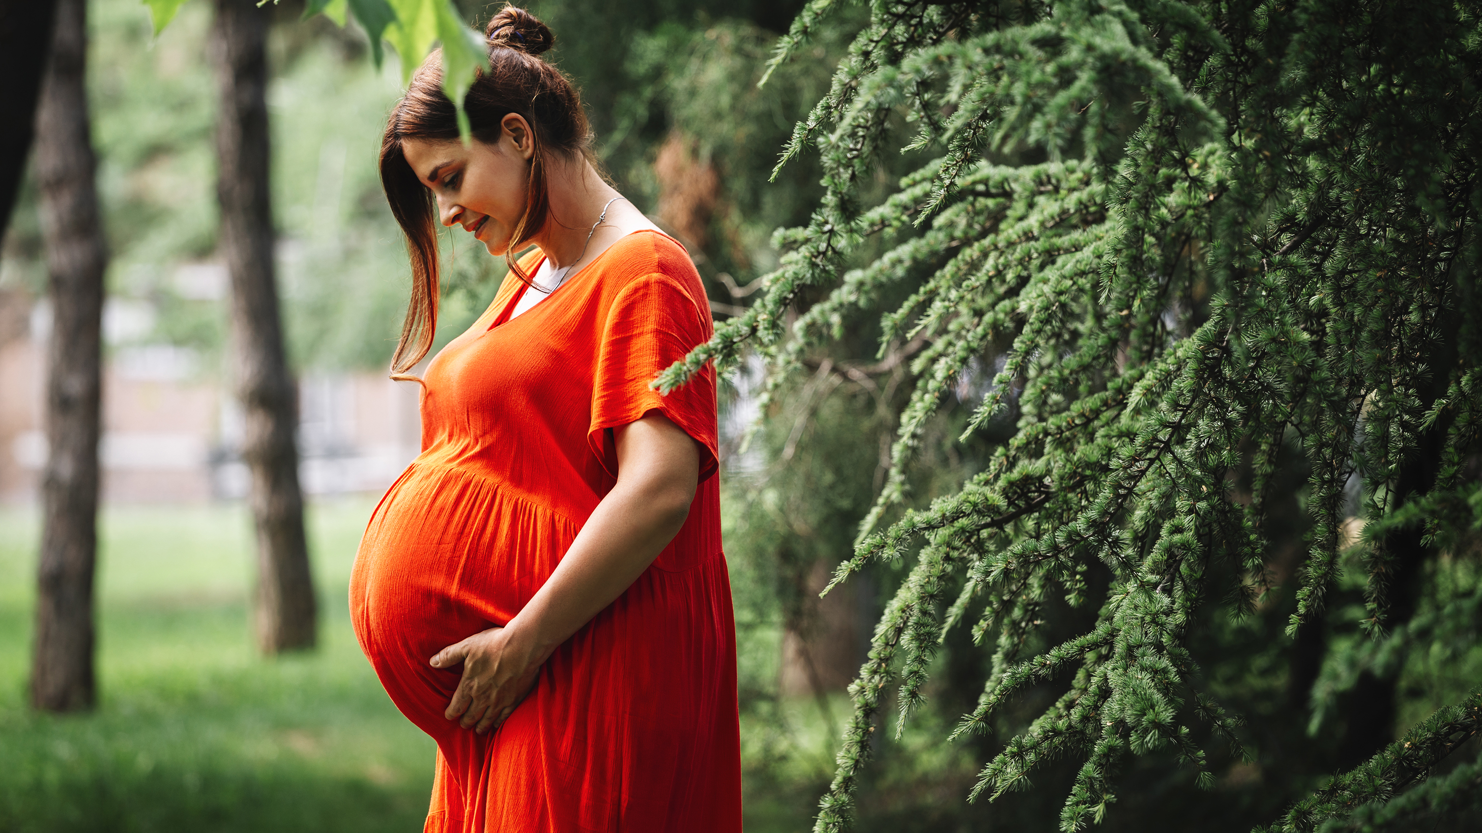
Bonus content

Slide 68
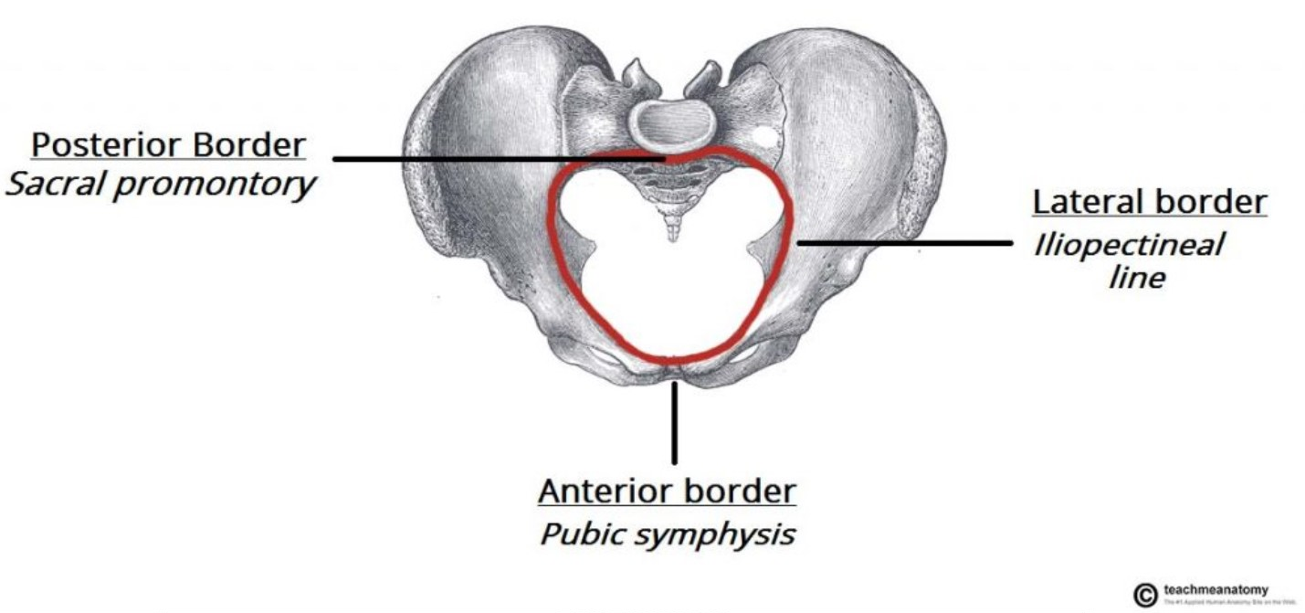
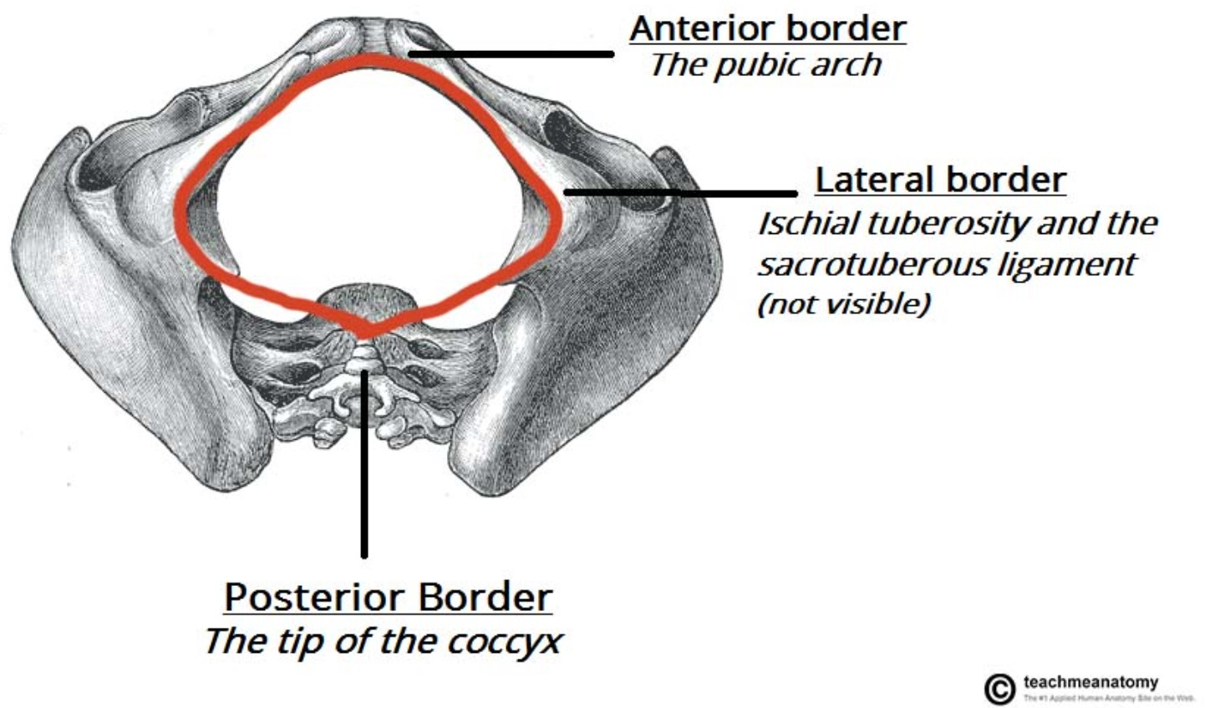
Anatomy of the Pelvis (2)
False Pelvis
Pelvic Inlet
True Pelvis
Pelvic Outlet
The Peer Teaching Society is not liable for false or misleading information…
Notes:
The pelvis is conceptualised as having two regions – the superior “false” and the inferior “true” regions.
Separated by the pelvic inlet, which you can see in the top image.
False pelvis contains abdominal organs, true pelvis contains bladder and female reproductive organs.
Pelvis also has an outlet (bottom image) – both important in childbirth.

Slide 69
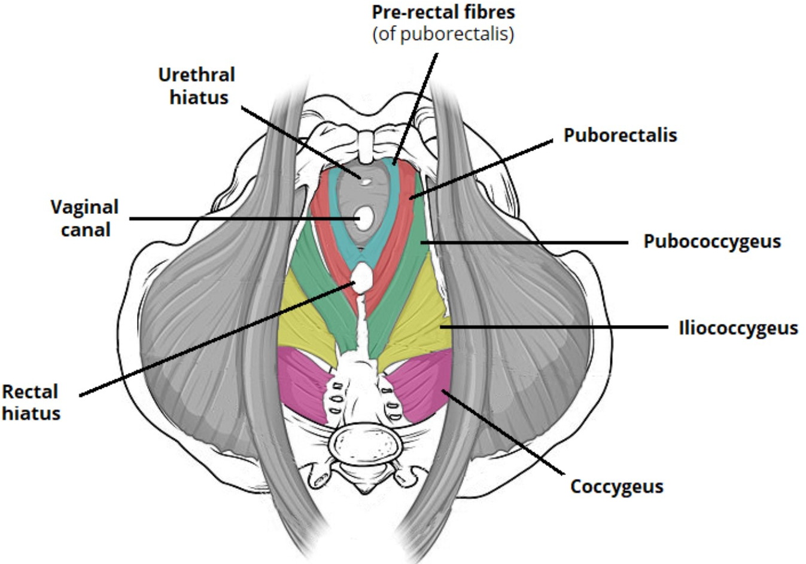
The pelvic floor
Supports abdominopelvic viscera
Coccygeus
Funnel-shaped sheet of muscles
Levator Ani:
Puborectalis
Pubococcygeus
Iliococcygeus
The Peer Teaching Society is not liable for false or misleading information…
Notes:
A quick slide on the pelvic floor – funnel shaped sheet of muscles
Made up of levator ani (further made up of puborectalis, pubococcygeus and iliococcygeus) and coccygeus
Sits below pelvic organs and acts as a supportive sling
Relevant later

Slide 70
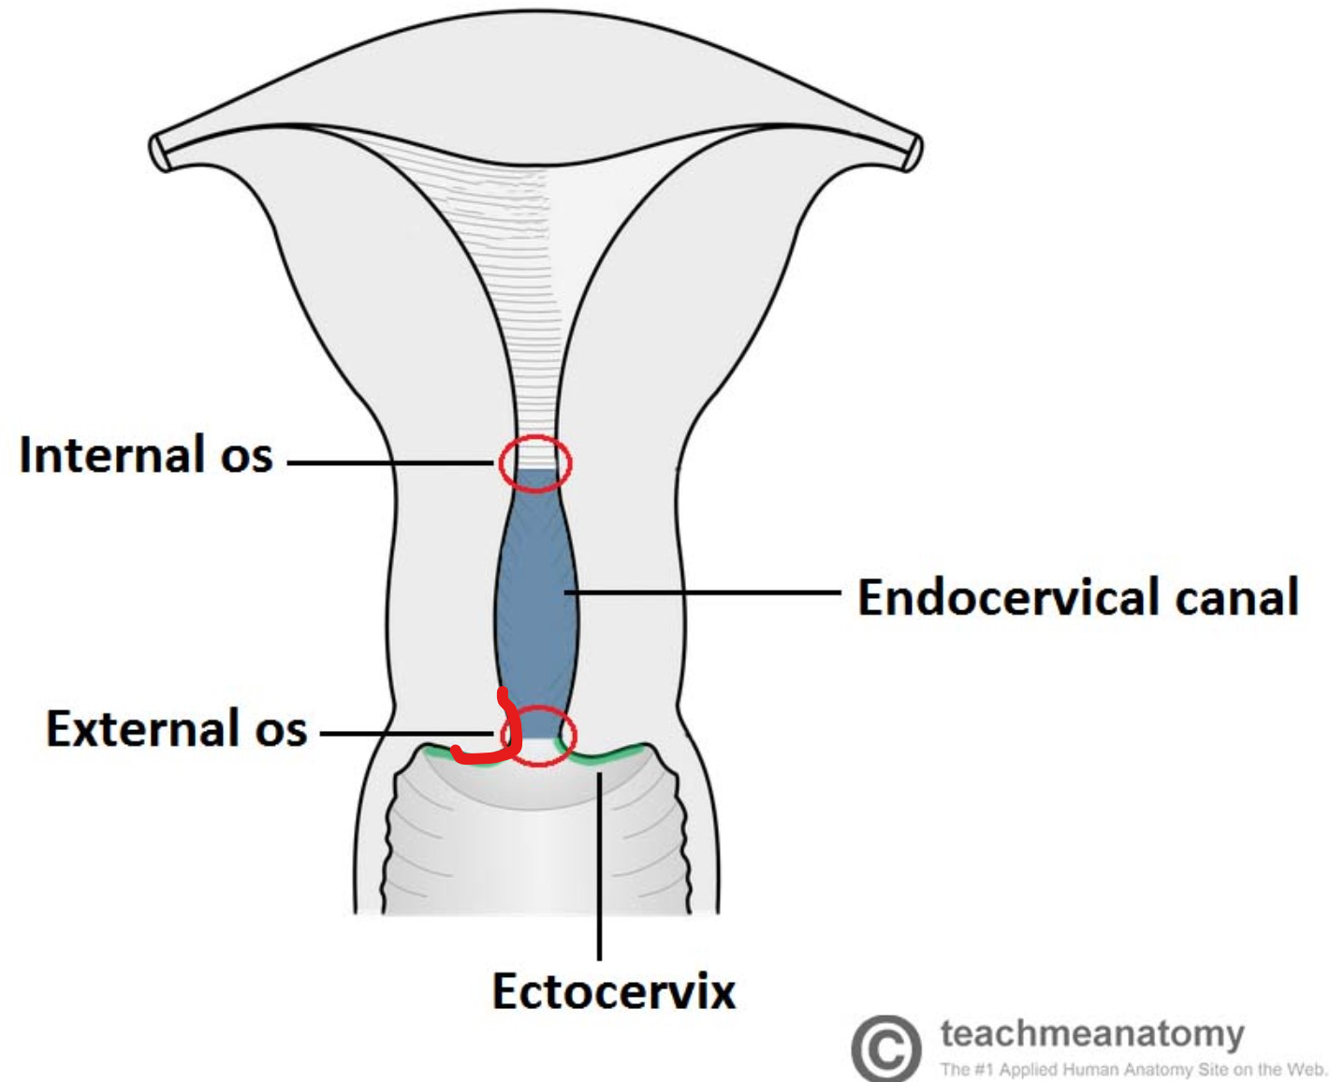
Cervix histology
Endocervix – mucous-secreting simple columnar epithelium
Ectocervix – projects into vagina, stratified squamous epithelium.
Cervical ectropion – endocervical cells spread to ectocervix
The Peer Teaching Society is not liable for false or misleading information…
Notes:
25mm tube between vagina and uterus
Bordered by internal and external os
Canal (endocervix) has simple columnar epithelium
Ectocervix has stratified squamous
Illustrative example – oestrogen can cause a cervical ectropion, which I’ve tried to draw on the diagram – essentially endocervix cells proliferate out onto the ectocervix and bleed easily – COCP, pregnancy.

Slide 71
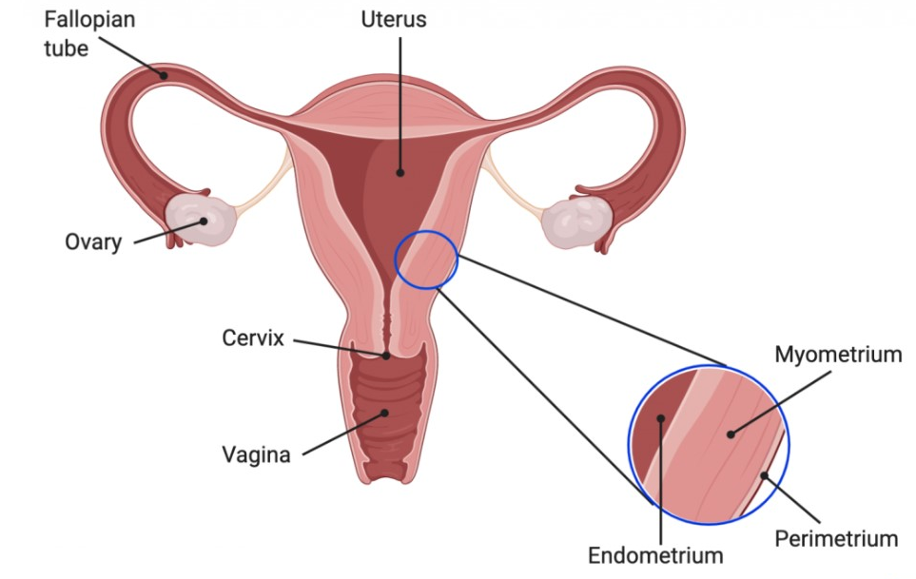
Uterus histology
Perimetrium / Serosa
Myometrium
Endometrium – simple columnar
Stratum basalis (not shed)
Stratum functionalis (shed)
The Peer Teaching Society is not liable for false or misleading information…
Notes:
Uterus has three layers: outer perimetrium, smooth muscle myometrium and inner endometrial lining
Endometrium is made up mainly of columnar epithelium and secretory glands.
Supplied by the spiral arterioles during the luteal phase.
Two layers – stratum functionalis is shed during a menstrual bleed.

Slide 72
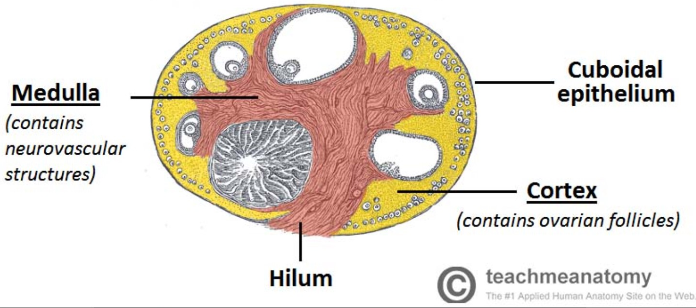
Ovary histology
Germinal epithelium
Connective tissue capsule
Cortex – follicles
Medulla – neurovascular supply
The Peer Teaching Society is not liable for false or misleading information…
Notes:
Ovaries have four layers – lined by germinal epithelium, a capsule, a cortex (which is where follicles develop) and a medulla in the middle.
Germinal epithelium is made up of cuboidal cells.
Sorry for all the histology – it does get relevant later.

