Slide 1
Inflammation and wound healing
Joseph Burdon + Tim Sargeant

Slide 2
Inflammation
= a localized physical condition in which part of the body becomes reddened, swollen, hot, and often painful, especially as a reaction to injury or infection.

Slide 3
Acute Inflammation

Slide 4
Causes of Acute Inflammation
Infection eg Cellulitis, Tonsillitis
Tissue necrosis eg Ischaemic Infarction
Hypersensitivity reactions eg Hayfever
Chemicals eg acid
Physical Agents eg trauma, temperature, foreign agents like a splinter

Slide 5
Macroscopic Appearance of Acute Inflammation
Rubor = Redness
Calor = Heat
Tumor = Swelling
Dolor = Pain
(Loss of Function)

Slide 6
Why do you get…
Redness → vasodilation/increased blood flow
Heat → vasodilation/increased blood flow
Swelling → oedema (and physical cell mass)
Pain → oedema puts pressure on structures
(Loss of Function → Use it or lose it)

Slide 7
Major Changes During Acute Inflammation
Vascular Changes:
Vasodilation
Vascular Permeability
Increased adhesion of leukocytes
Cell Changes:
Cellular Recruitment
Activation of neutrophils

Slide 8
Chemical Mediators of Acute Inflammation
Vasodilation mediated by:
Histamine
Prostaglandins
Nitric oxide
VIP (vasoactive intestinal peptide)
PGE2/I2 (Prostaglandin E2)
PAF (Platelet Activating Factor)

Slide 9
Chemical Mediators of Acute Inflammation
Increased Vascular Permeability mediated by:
Histamine
Bradykinin
Nitric oxide
PAF (Platelet Activating Factor)

Slide 10
Chemical Mediators of Acute Inflammation
Increased Adhesion of Leukocytes mediated by:
IL-8
IL-1
Complement Component C5a
Leucotriene B4
PAF (Platelet Activating Factor)
TNF-alpha

Slide 11
What happens next?
Normally → RESOLUTION
But if there is excessive exudate → SUPPURATION
If there is excessive necrosis → REPAIR AND ORGANISATION
Note: ORGANISATION = Replacement of tissues with granulation tissue (tissue of repair comprised of proliferating small blood vessels in a connective tissue matrix with myofibroblasts and deposited extracellular matrix proteins )
If there is a persistent causative agent → CHRONIC INFLAMMATION

Slide 12
Acute Inflammation: GOOD and BAD
Good because:
Removal of toxins
Entry of antibodies
Transport of drugs
O2/nutrient delivery
Fibrinous exudate traps microorganisms
Bad because:
Swelling, Pain, Redness, Heat
Digestion of normal tissues
Inappropriate inflammatory response eg Type I Hypersensitivity

Slide 13
Exudate
Formation of exudate caused by increased vascular permeability.
Increased vascular permeability causes the transit of plasma proteins (eg Antibodies and Fibrin) into the extracellular space.
Proteins + Fluid → Oedema → Swelling

Slide 14
Transudate Vs Exudate
Congestive Heart Failure
Nephrotic Syndrome
Cirrhosis
Malignancy
Infection
Inflammatory Disorders
https://www.youtube.com/watch?v=RE0sT0DYB6k

Slide 15
Q. Clinically how may you differentiate transudate from exudate?

Slide 16
Chronic Inflammation

Slide 17
Causes of Chronic Inflammation
Primary Chronic Inflammation
INFECTIVE: Tuberculosis
AUTOIMMUNE: Hashimoto’s Thyroiditis, Rheumatoid Arthritis
PRIMARY GRANULOMATOUS: Crohn’s Disease, Sarcoidosis
OTHER: Ulcerative Colitis
Transplant Rejection
Progression from Acute Inflammation

Slide 18
Macroscopic Appearance of Chronic Inflammation
Chronic Ulcer eg peptic
Chronic Abscess Cavity eg osteomyelitis
Granulomatous Inflammation eg caseous necrosis in TB
Fibrosis. Occurs when most of cellular infiltrate has subsided. Eg chronic cholecystitis

Slide 19
Cell Types Acute Vs Chronic
ACUTE
Neutrophil
CHRONIC
Lymphocyte
Macrophage*
Plasma Cell

Slide 20
Epithelioid Histiocytes
Granuloma = an aggregation of epithelioid histiocytes.
*Epithelioid histiocytes are specialised form of macrophages. They resemble epithelial cells.

Slide 21
Systemic Effects of Inflammation
Pyrexia – endogenous pyrogens (produced by polymorphs and macrophages and stimulated by phagocytosis) act on hypothalamus’ thermoregulatory mechanisms to inc. temp.
Malaise
Weight loss – due to negative nitrogen balance in chronic inflammation
Increased ESR – due to alterations in plasma proteins
Leucocytosis – eg neutrophilia, eosinophilia , lymphocytosis
Anaemia – blood loss in exudate or haemolysis by toxins

Slide 22
Wound Healing

Slide 23
Types of Wound
Clean
Sterile and likely to heal without complications (surgical)
Contaminated
Pathogens and foreign bodies present (e.g stab wound)
Infected
Multiplying pathogenic organisms. Yellow / pus / pain / redness (e.g abcess)
Colonized
Chronic wound, multiple organisms present, difficult to heal (e.g pressure sore)

Slide 24
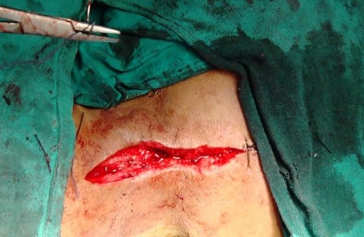
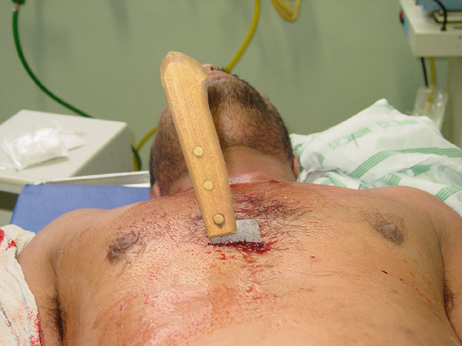
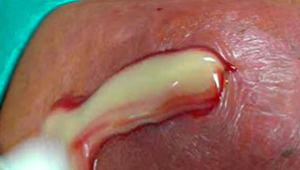
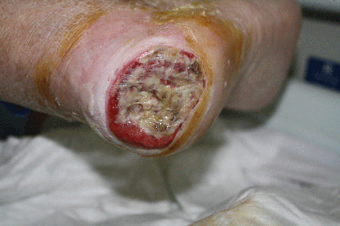

Slide 25
Open v Closed
Open
Incisional (knife / glass)
Laceration (blunt trauma)
Abrasion (superficial to epidermis)
Puncture / penetration / gunshot
Closed
Haematoma – collection of blood under the skin Internal trauma – petechiae / purpura External trauma – contusion (bruise)
Crush Injury – Long compression Rhabdomyolysis – Damage to skeletal muscle - > Kidney failure, shock, compartment syndrome

Slide 26
4 Phases of Healing
Haemostasis (Vascular response)
Inflammatory response
Proliferation
Maturation

Slide 27
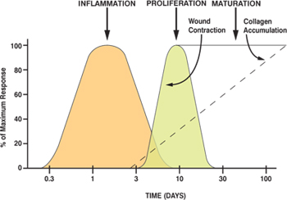

Slide 28
Haemostasis
Clot formation
Platelet activation
Coagulation cascade
Stops blood loss, prevents pathogens entering
Vasoconstriction
Sympathetic reflex response
Reduced blood flow thf. Reduced blood loss...

Slide 29
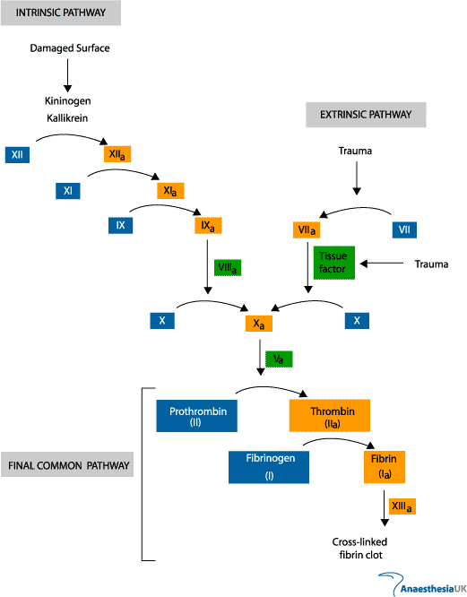
Coagulation Cascade
Vitamin K dependant factors II, VII, IX, X

Slide 30
Platelet Plug Formation
Adherence - Platelets attach to collagen / fibrin mesh in the presence of Von Willebrand’s Factor in the vessel walls
Activation – ADP and TX2 release in positive feedback loop. Initiates inflammation.
Aggregation – Attracts more platelets to the site and causes contraction of the mesh

Slide 31
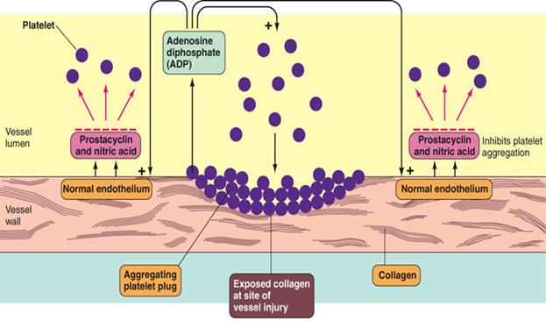

Slide 32
Inflammation
Platelets release inflammatory mediators e.g histamine, prostaglandins, PDGF (platelet derived growth factor)
Vasodilation, vascular permeability, chemotaxis of inflammatory cells

Slide 33
Inflammation
Neutrophils peak 24-48 hours
Free radical release, bactericidal, phagocytosis
Macrophages peak 48-96 hours
Phagocytosis, attraction of lymphocytes / fibroblasts
Lymphocytes peak 96 hours
Mainly fibroblast recruitment by chemokine production

Slide 34
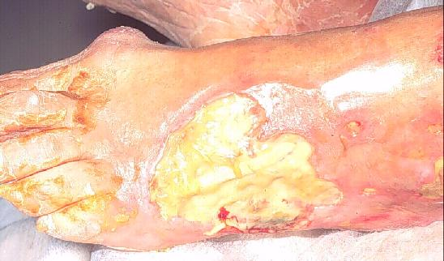
Inflammation
Lasts around 7 days
Indefinite in colonized wounds which is why they always look inflamed
Slough formed of cell debris accumulates

Slide 35
Chronic Inflammation - Ulcers
Arterial insufficiency | Venous insufficiency
Poor circulation (PAD, diabetes, smoking, HTN, renal failure) | Valve failure and reflux (varicose veins, previous DVT, HTN, surgery)
Painful | Painless unless infected
Found on feet / heels / toes. Well defined border | Below the knee, often medial malleolus
Associated intermittent claudication | Associated lymphoedema

Slide 36
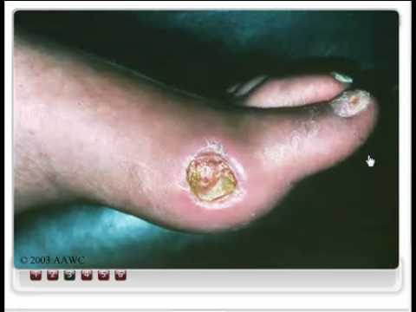
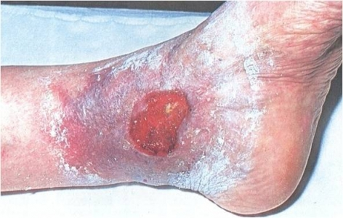

Slide 37
Proliferation
Usually occurs 2-4 days after wound formation
Characterized by formation of granulation tissue (scar)
This replaces specialised tissue which cannot be replaced
DON’T CONFUSE GRANULOMA AND GRANULATION TISSUE!!!!!!!!!!!!!!!!!!!!!

Slide 38
Organisation
Angiogenesis
Granulation
Contraction
Phagocytosis of dead cells

Slide 39
Angiogenesis
Anastomoses
BM broken by proteases
Endothelial xcells proliferate and anastomose
BM relaid for vascular continuity

Slide 40
Granulation Tissue
Formed of capillary loops + myofibroblasts
Fibroblasts recruited by chemokines / inflam.
Secretion of collagen and matrix compounds (GAGs, fibronectin etc)
Myofibroblasts formed by fibro. + muscle fibres. They have features of fibroblasts and smooth muscle
Excessive granulation tissue is called proud flesh

Slide 41
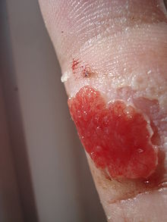

Slide 42
Contraction
Contraction of myofibroblasts (contain smooth muscle)
Collagen type III matures to stronger type I
Brings the epithelial surfaces closer together to allow for re-epithelialization
Complications – can cause stenosis if damage is circumferential around a lumen ie gut / sphincter

Slide 43
Maturation
Begins around 20 days after initial wound
Reduced collagen production
Tensile strength increases as collagen is re-arranged and cross linked along tension lines

Slide 44
Factors affecting wound healing
Infection
Diabetes
Oedema
Malnutrition (esp. Vit C deficiency)
Immunocomprimise
Smoking
Inadequete perfusion

Slide 45
What hasn’t been covered
Fracture healing
http://radiopaedia.org/articles/fracture-healing
GI ulcers
https://www.youtube.com/watch?v=wARGyh_C0MU
ECM compounds

Slide 46
State the 4 macroscopic features of acute inflammation
Rubor
Calor
Dolor
Tumour

Slide 47
State 3 vascular changes which occur in acute inflammation
Vasodilation
Increased permeability
Increased adhesion of leukocytes

Slide 48
Which of the following is NOT a chemical mediator of vasodilation in acute inflammation
Histamine
Nitric Oxide
Prostaglandins
Neutrophils
Platelet Activating Factor

Slide 49
State the 4 potential consequences of acute inflammation
Resolution
Suppuration
Repair and Organisation
Progression to Chronic Inflammation

Slide 50
State 2 conditions which commonly cause the formation of exudate
Malignancy
Infection
Inflammatory

Slide 51
State an autoimmune cause of Chronic Inflammation
Crohn’s
UC
RA
Hashimoto’s Thyroiditis etc

Slide 52
Define ‘granuloma’
A collection of epithelioid histiocytes

Slide 53
3 features of a wound that suggest infection?
Pus
Redness
Pain
Poor healing

Slide 54
Which factor is needed for the conversion of prothrombin to thrombin?
Factor 10a

Slide 55
What is the end product of the common pathway of the coagulation cascade?
Fibrin

Slide 56
Contaminatedopen incisional wound

Slide 57
What are the two main constituents of granulation tissue?
Myofibroblast+
Capillary loop

Slide 58
What are the 4 phases of wound healing?
Haemostasis
Inflammation
Proliferation
Maturation

Slide 59
A diabetic patient is being treated for a chronic wound on their foot which is painful. What is the likely lesion?
Arterial ulcer

Slide 60
What are the vitamin k dependant clotting factors?
II, VII, IX, X

Slide 61
A patient with a long history of gallstones complains of excessive bleeding for the past few weeks. What vitamin deficiency could be causing this?
Vitamin K
deficiency

